Slide 1
An NSS Audio-Visual
Library Presentation
Bats:
Myths and Reality
Bat Conservation International
S404 81 Slides 1/27/2021

Slide 3
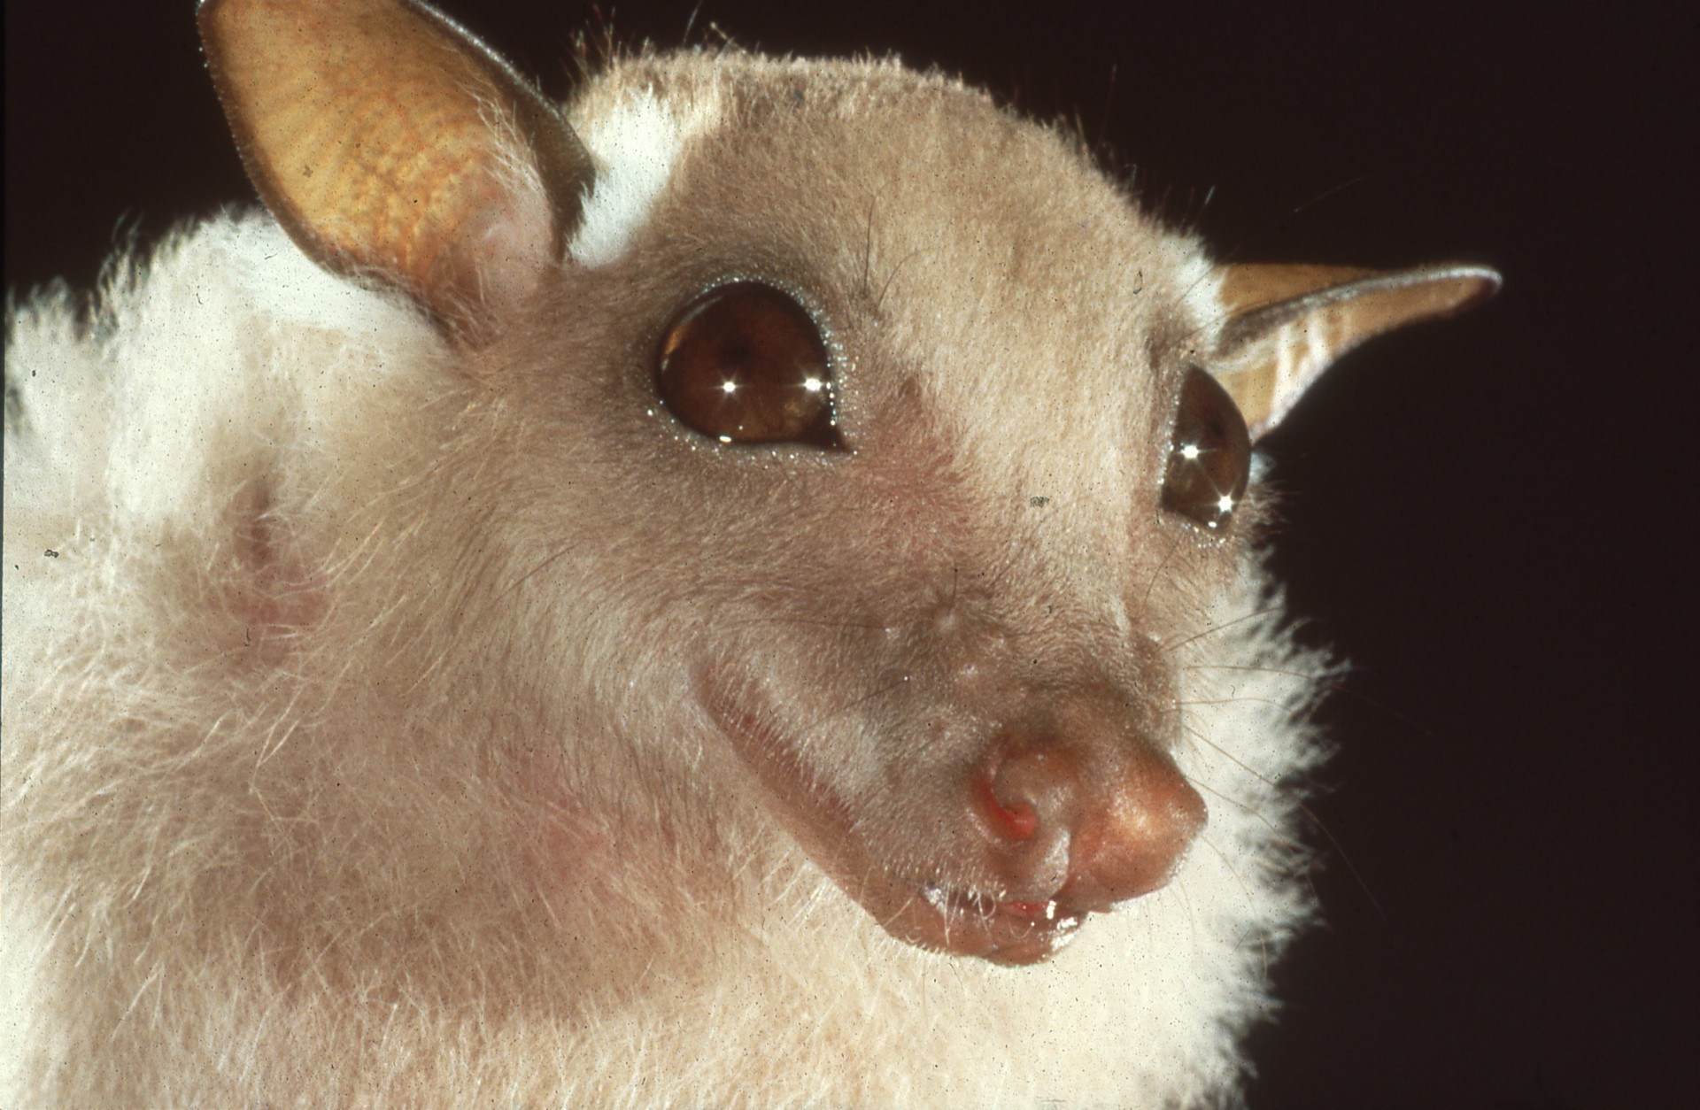
Notes:
Bats are among the world’s most fascinating, beneficial, and likeable animals. Yet we easily misunderstand and often fear and persecute them.

Slide 4
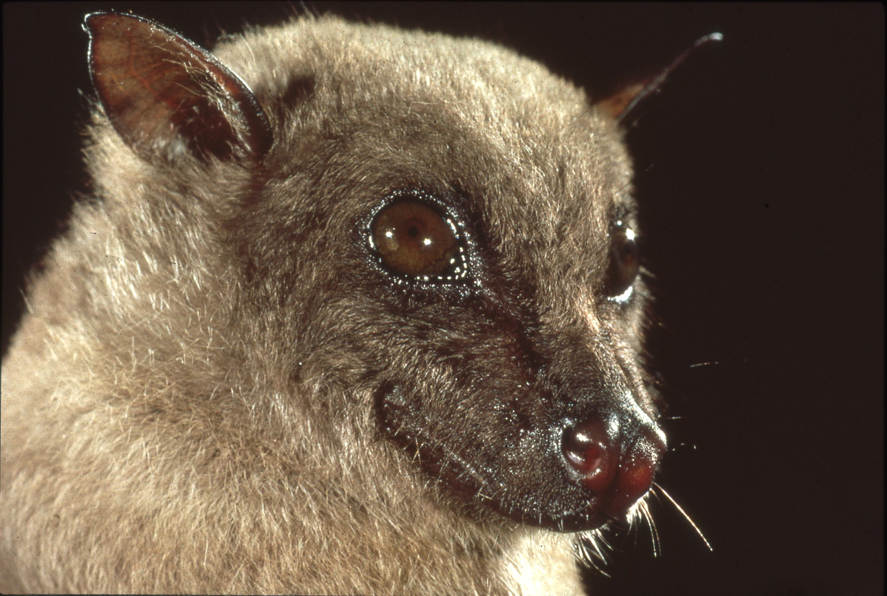
Notes:
Nearly 1000 kinds comprise almost a quarter of all mammal species. They live in all but the most extreme desert and polar regions.

Slide 5
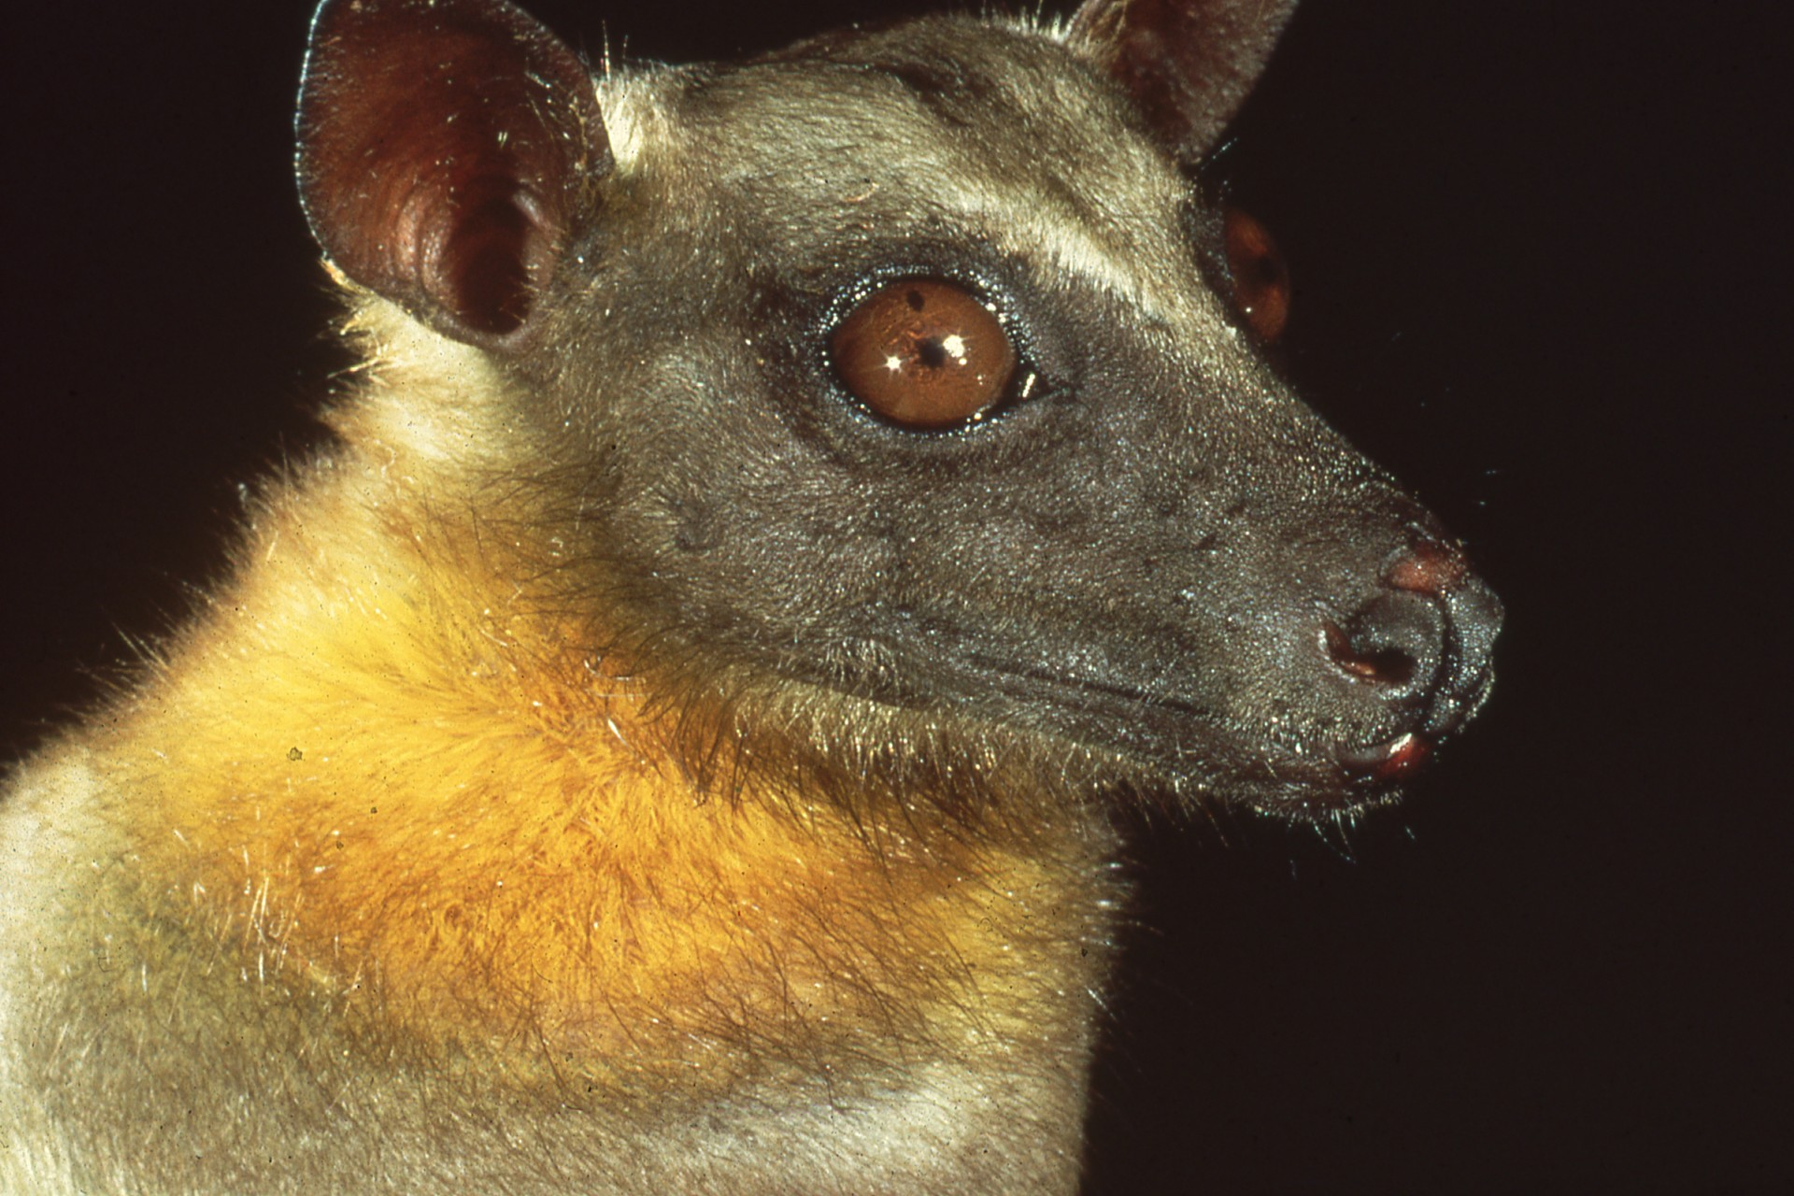
Notes:
But bats like this are disappearing rapidly, victims of human ignorance.

Slide 6
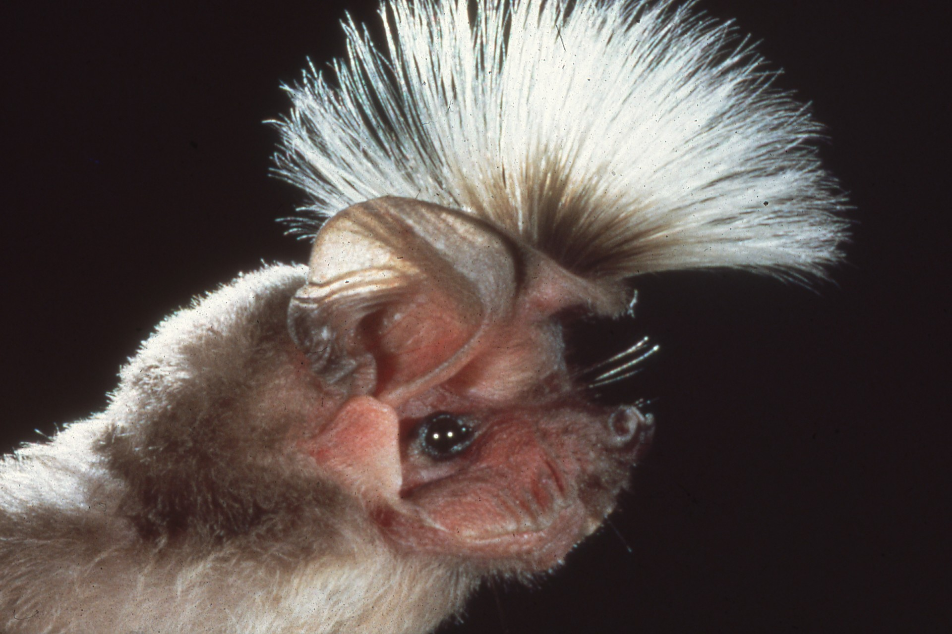
Notes:
They come in an enormous variety, from crested bats, …

Slide 7
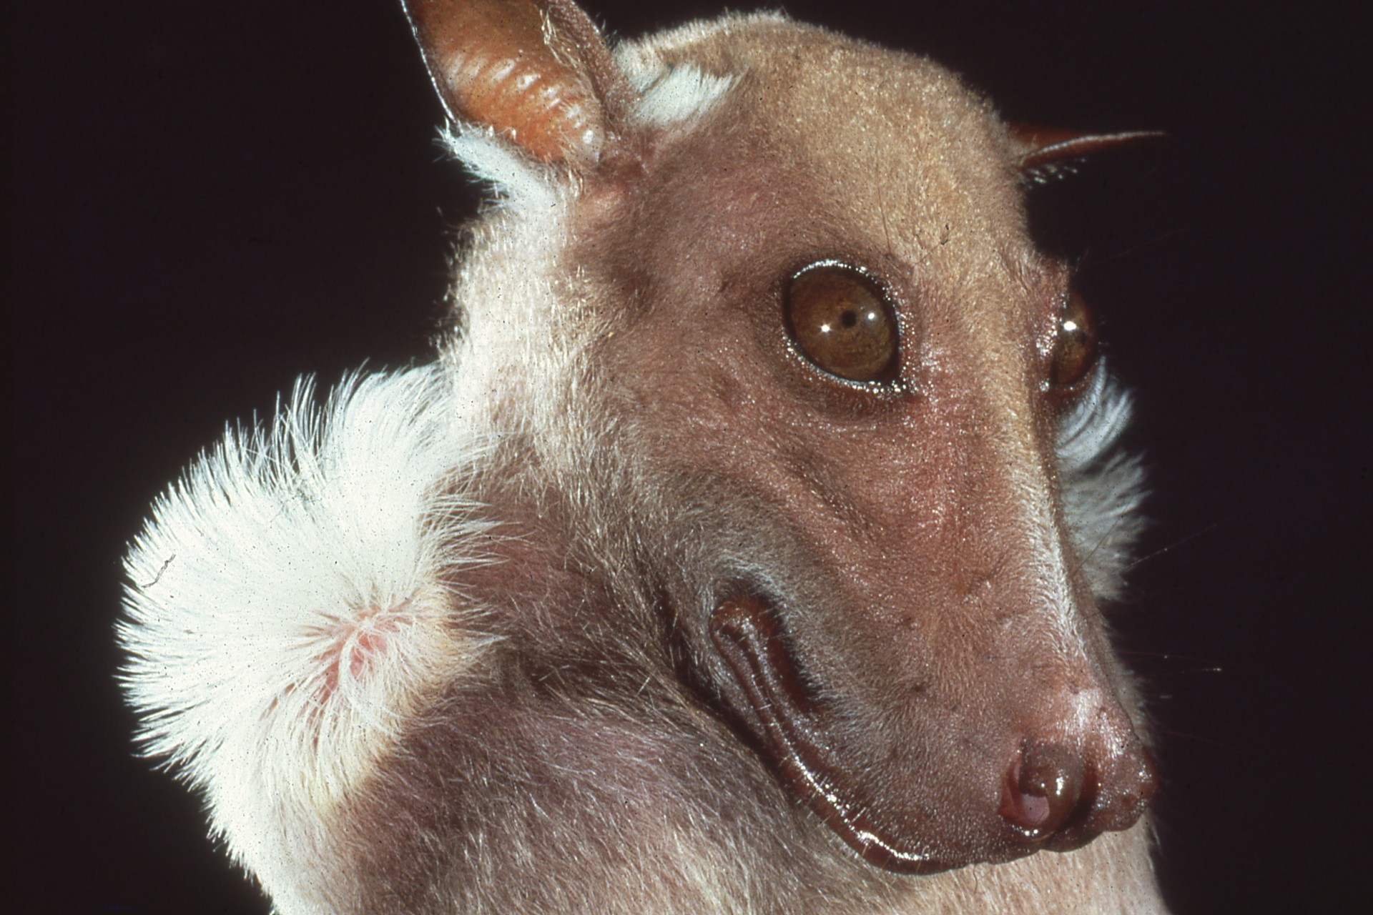
Notes:
…to epauletted bats, from big eyes, …

Slide 8
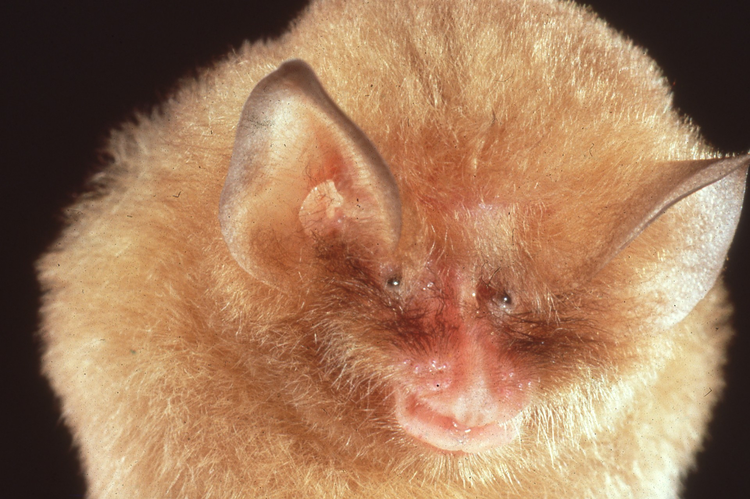
Notes:
…to tiny eyes, and from funnel ears, …

Slide 9
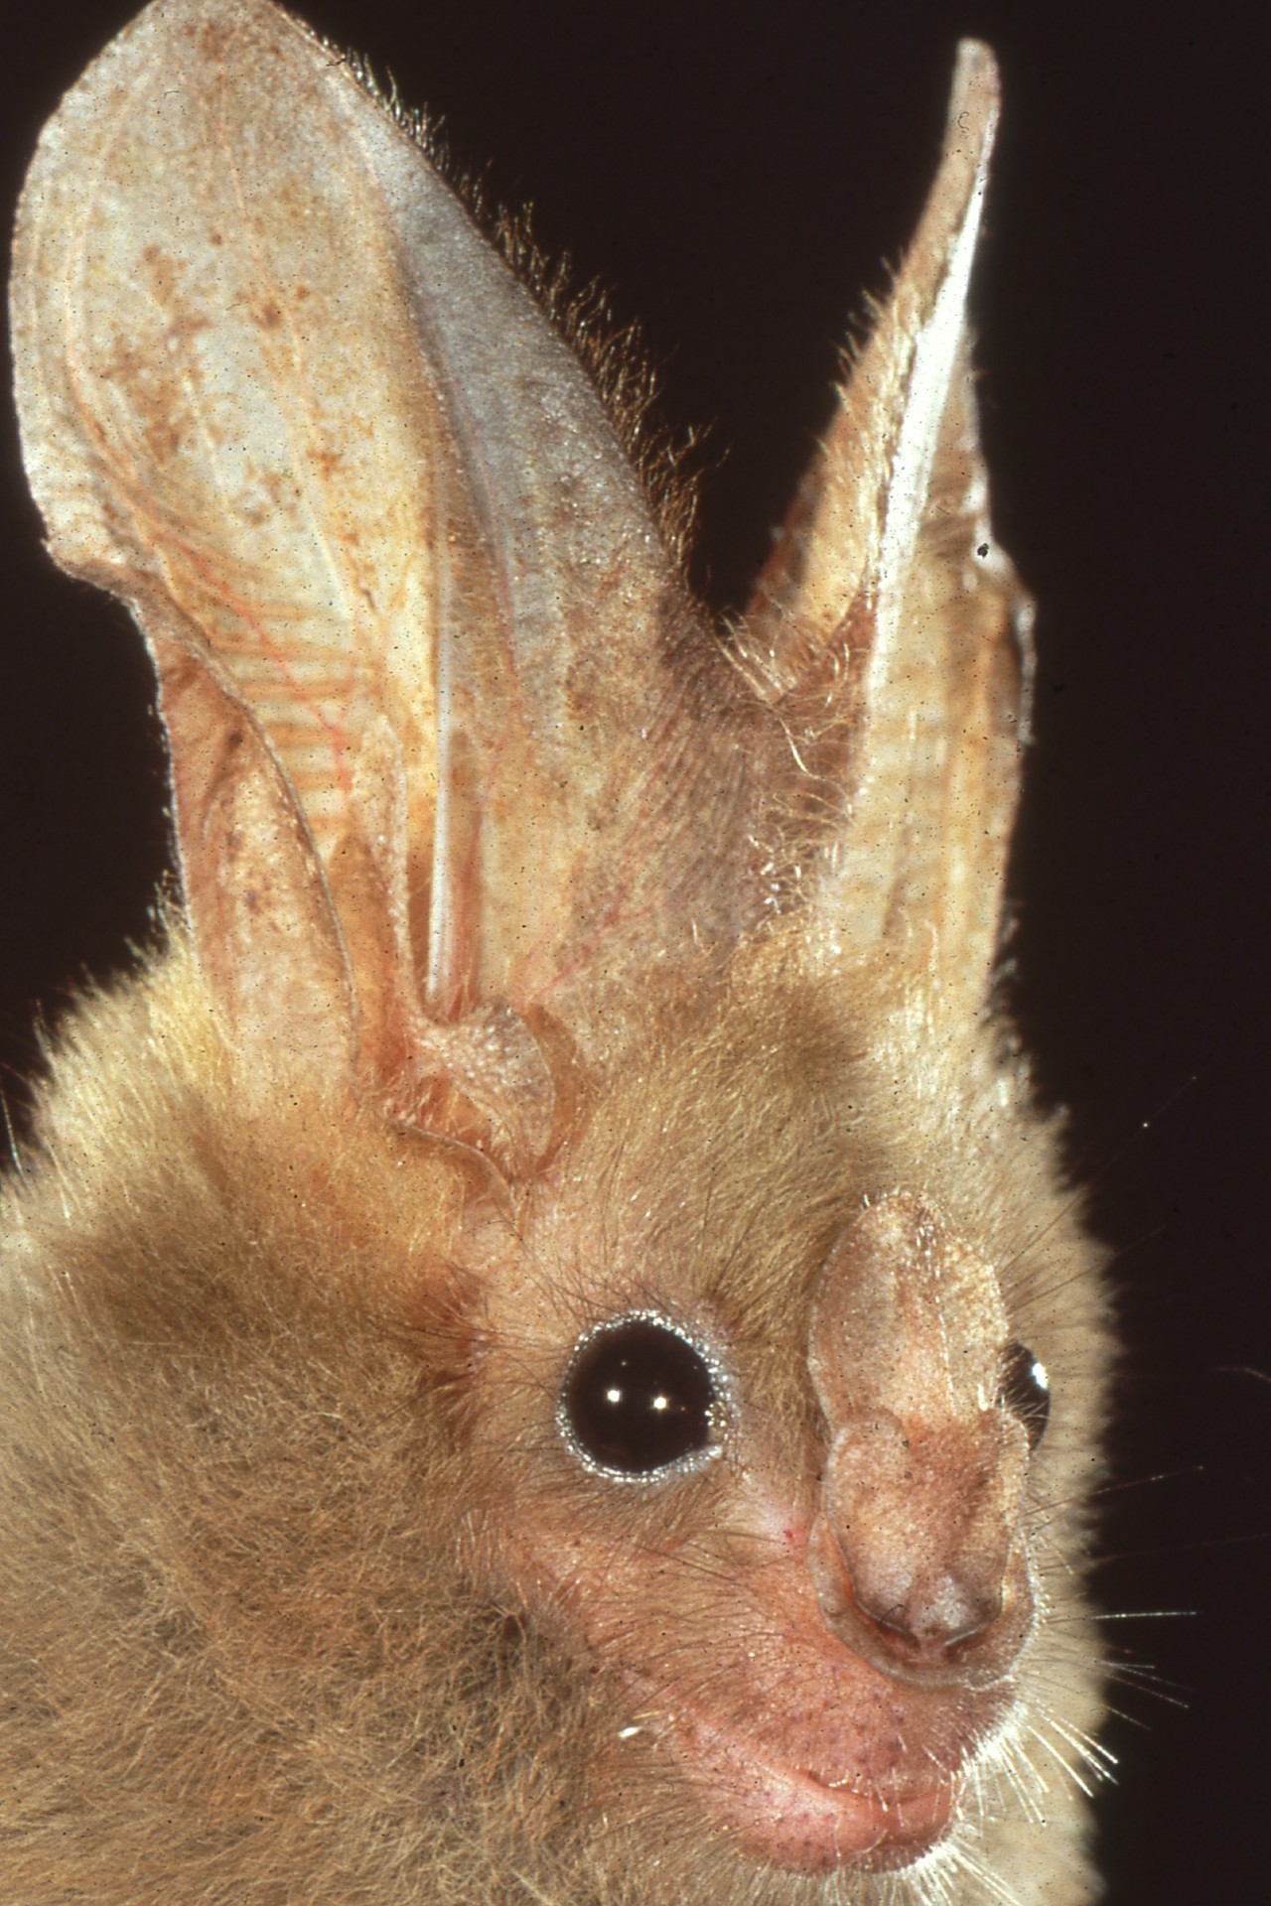
Notes:
…to rabbit ears. Some have strange faces, …

Slide 10
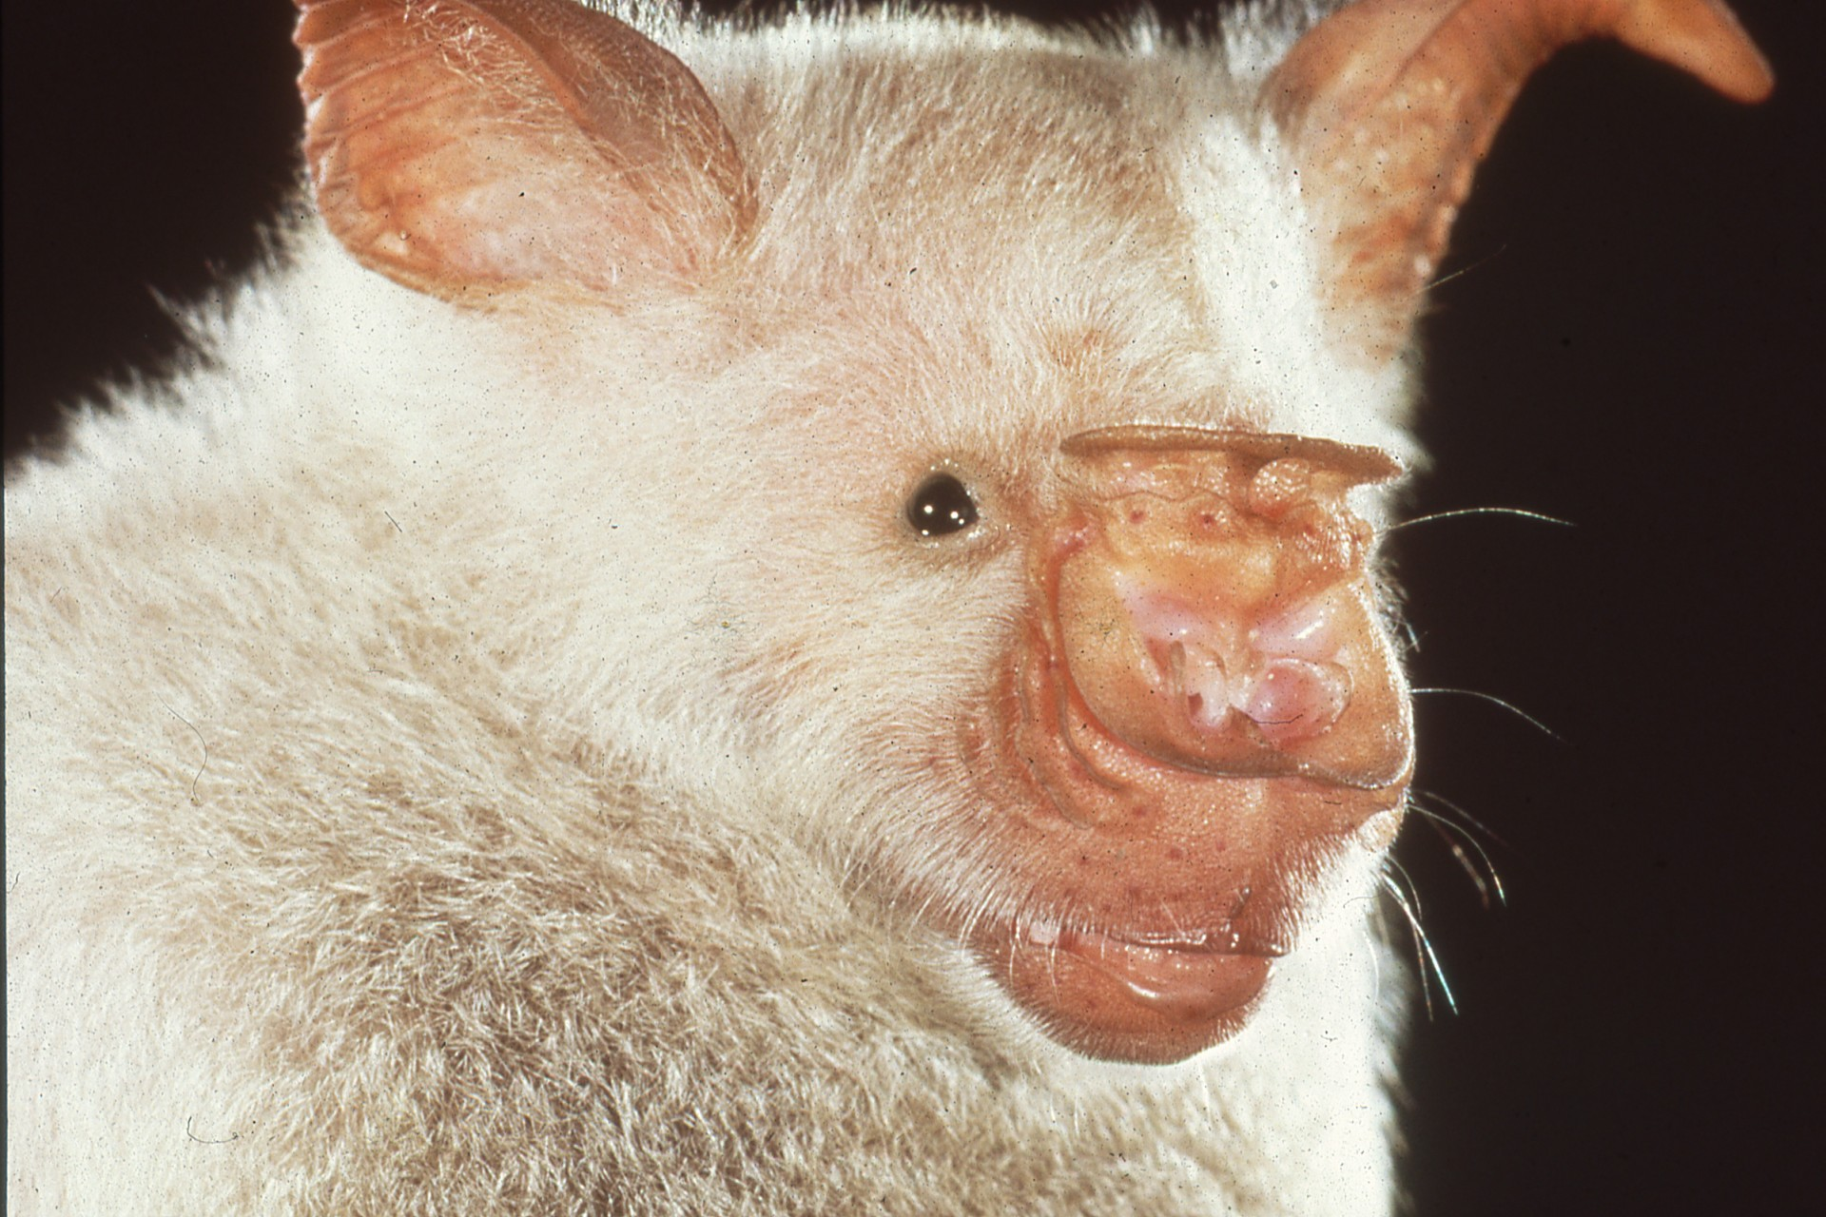
Notes:
…but even these are beautiful to scientists who study the sophistications of bat navigation. The echolocation systems of bats like this…

Slide 11
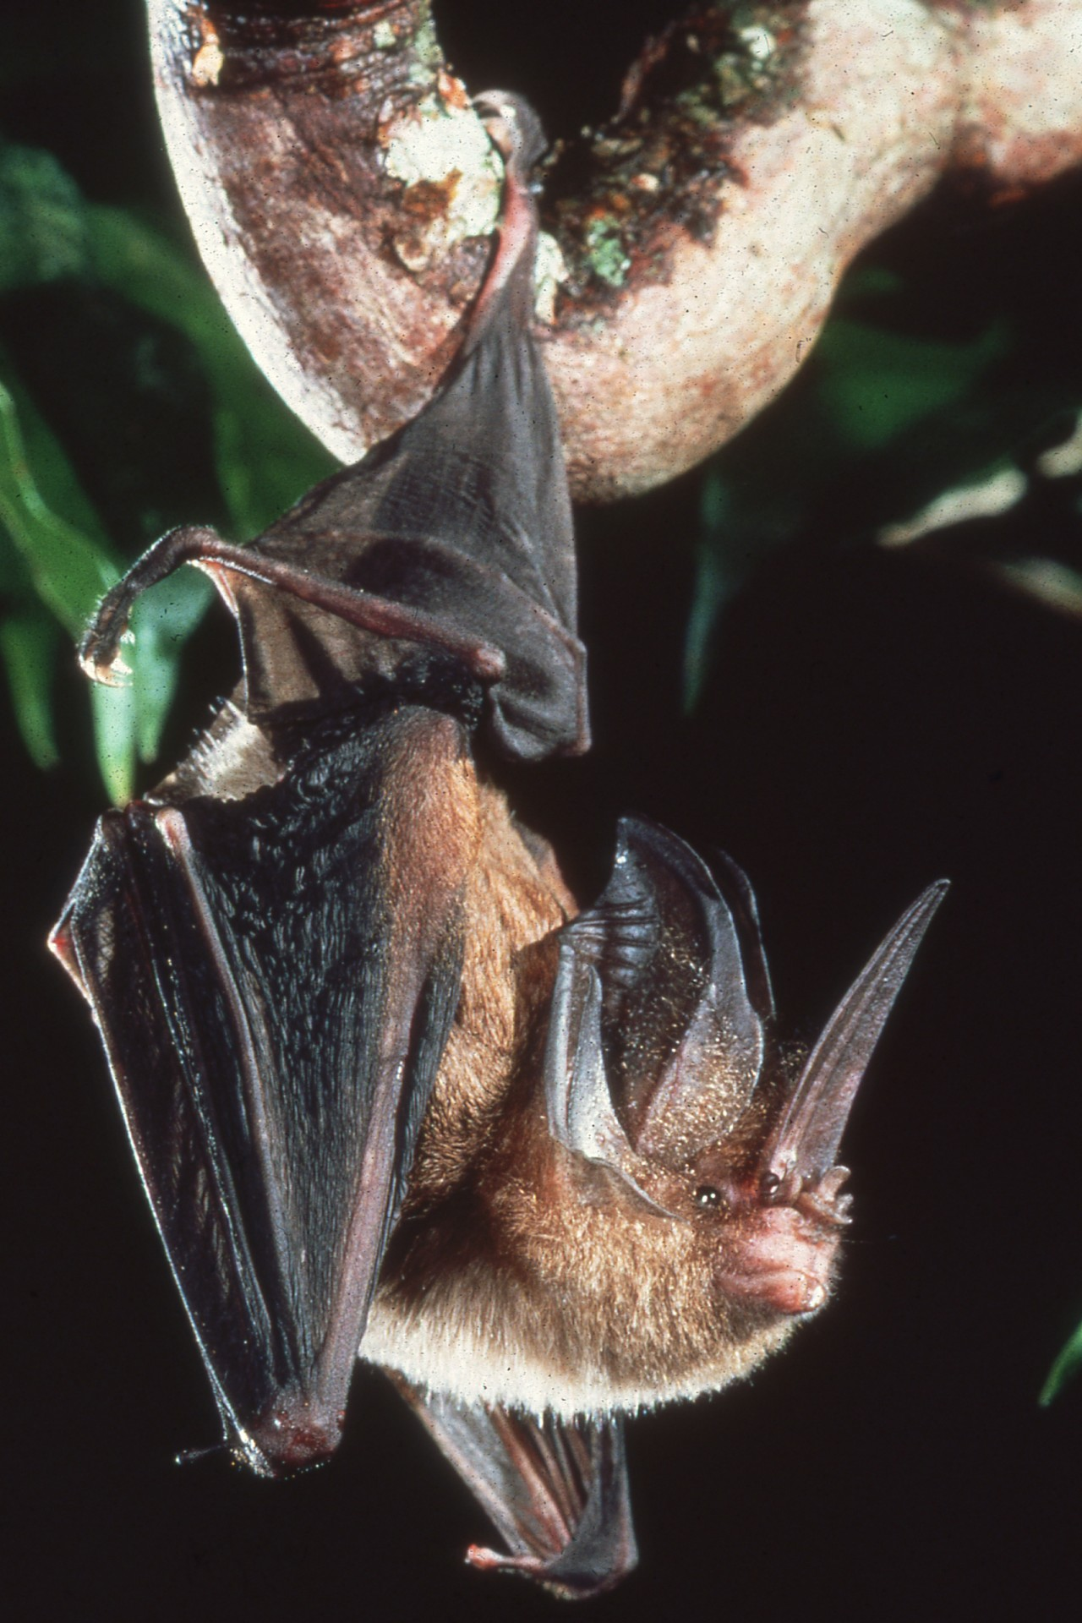
Notes:
… currently surpass scientific understanding and are far more efficient than any similar system developed by human beings.

Slide 12
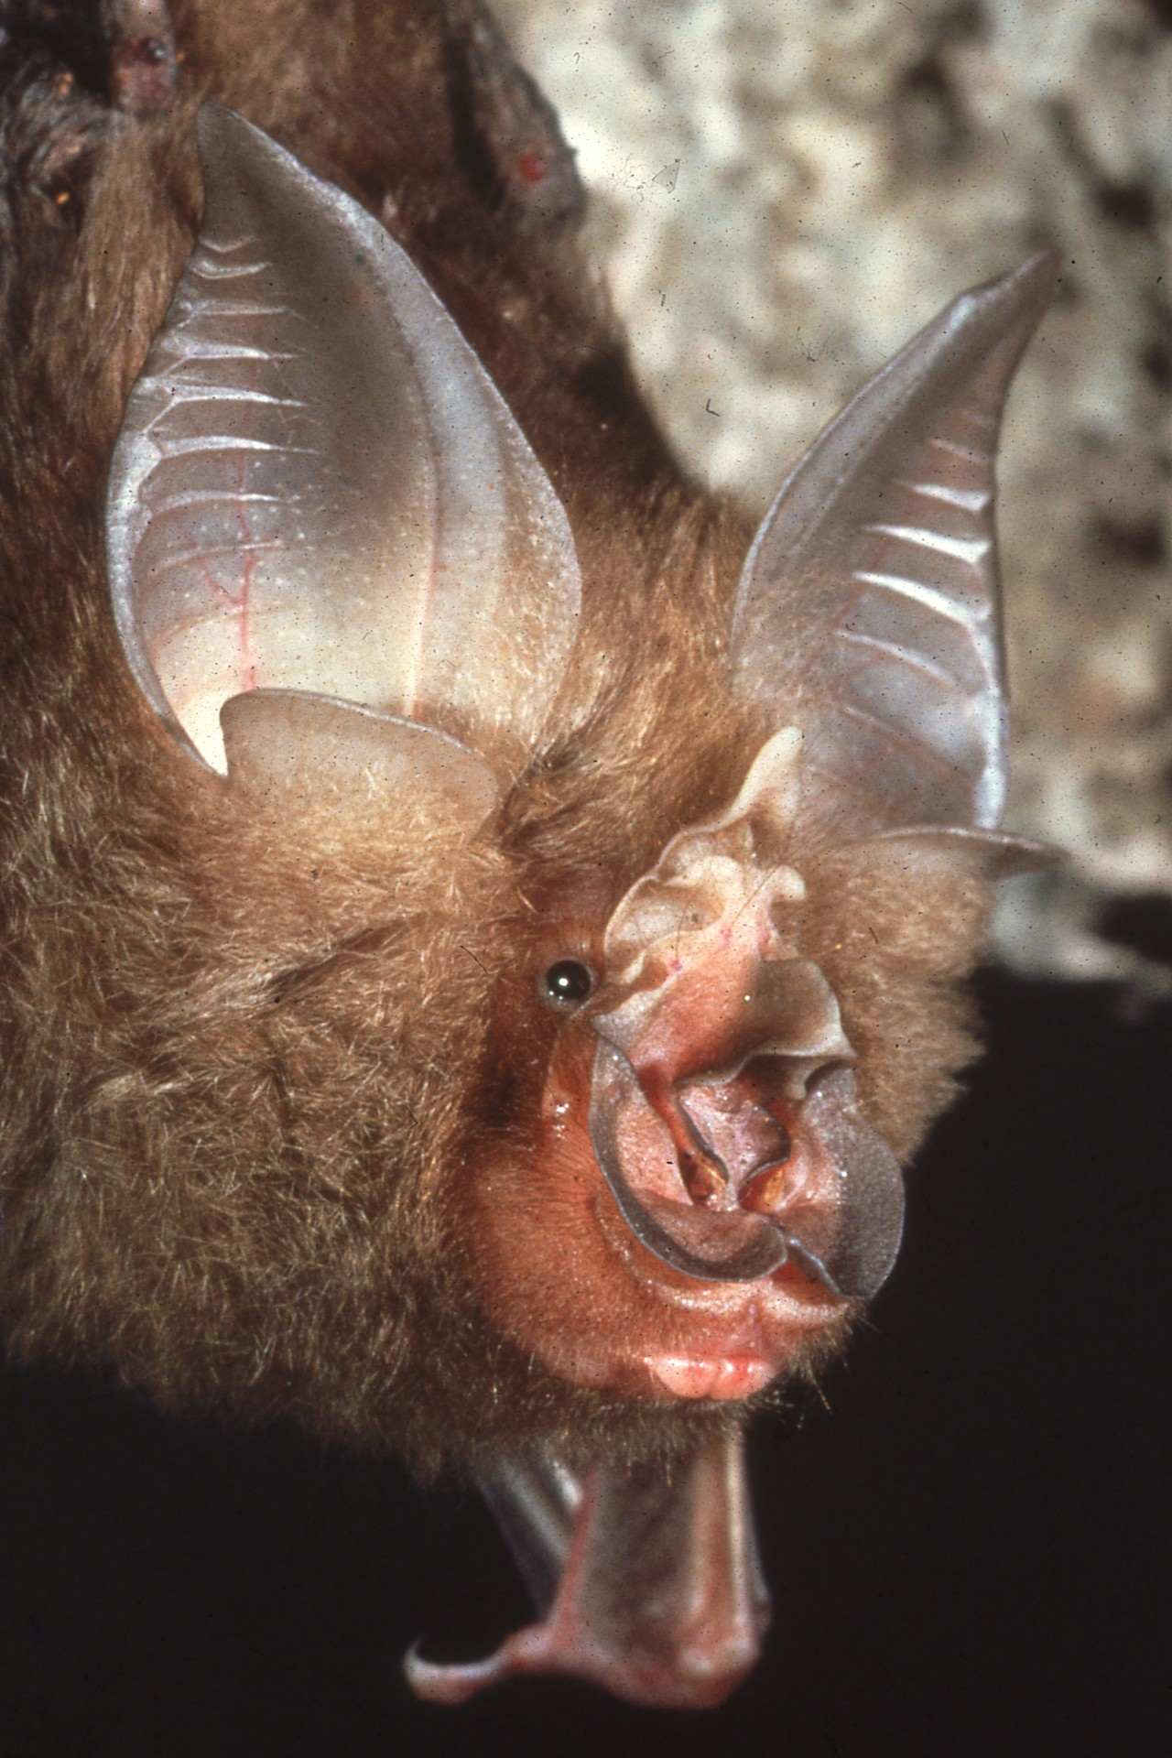
Notes:
Using special flaps and nose leaves, bats can use sound alone to detect obstacles as fine as a human hair, and can see everything but color on the darkest night. They also have eyes, and no bats are blind.

Slide 13
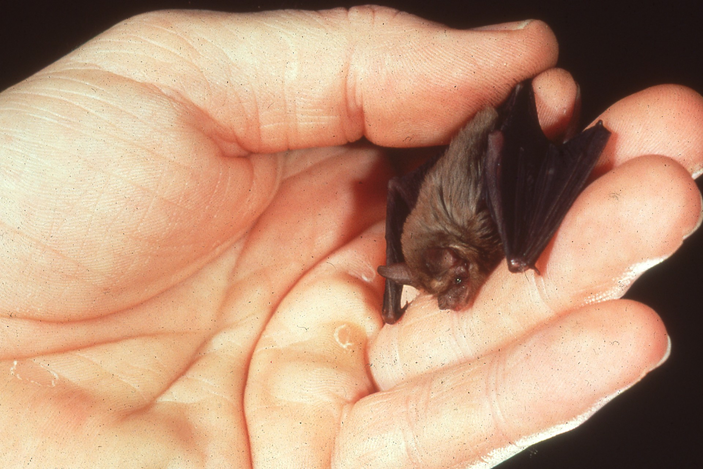
Notes:
The world’s smallest mammal, the bumblebee bat of Thailand, weighs less than a penny.

Slide 14
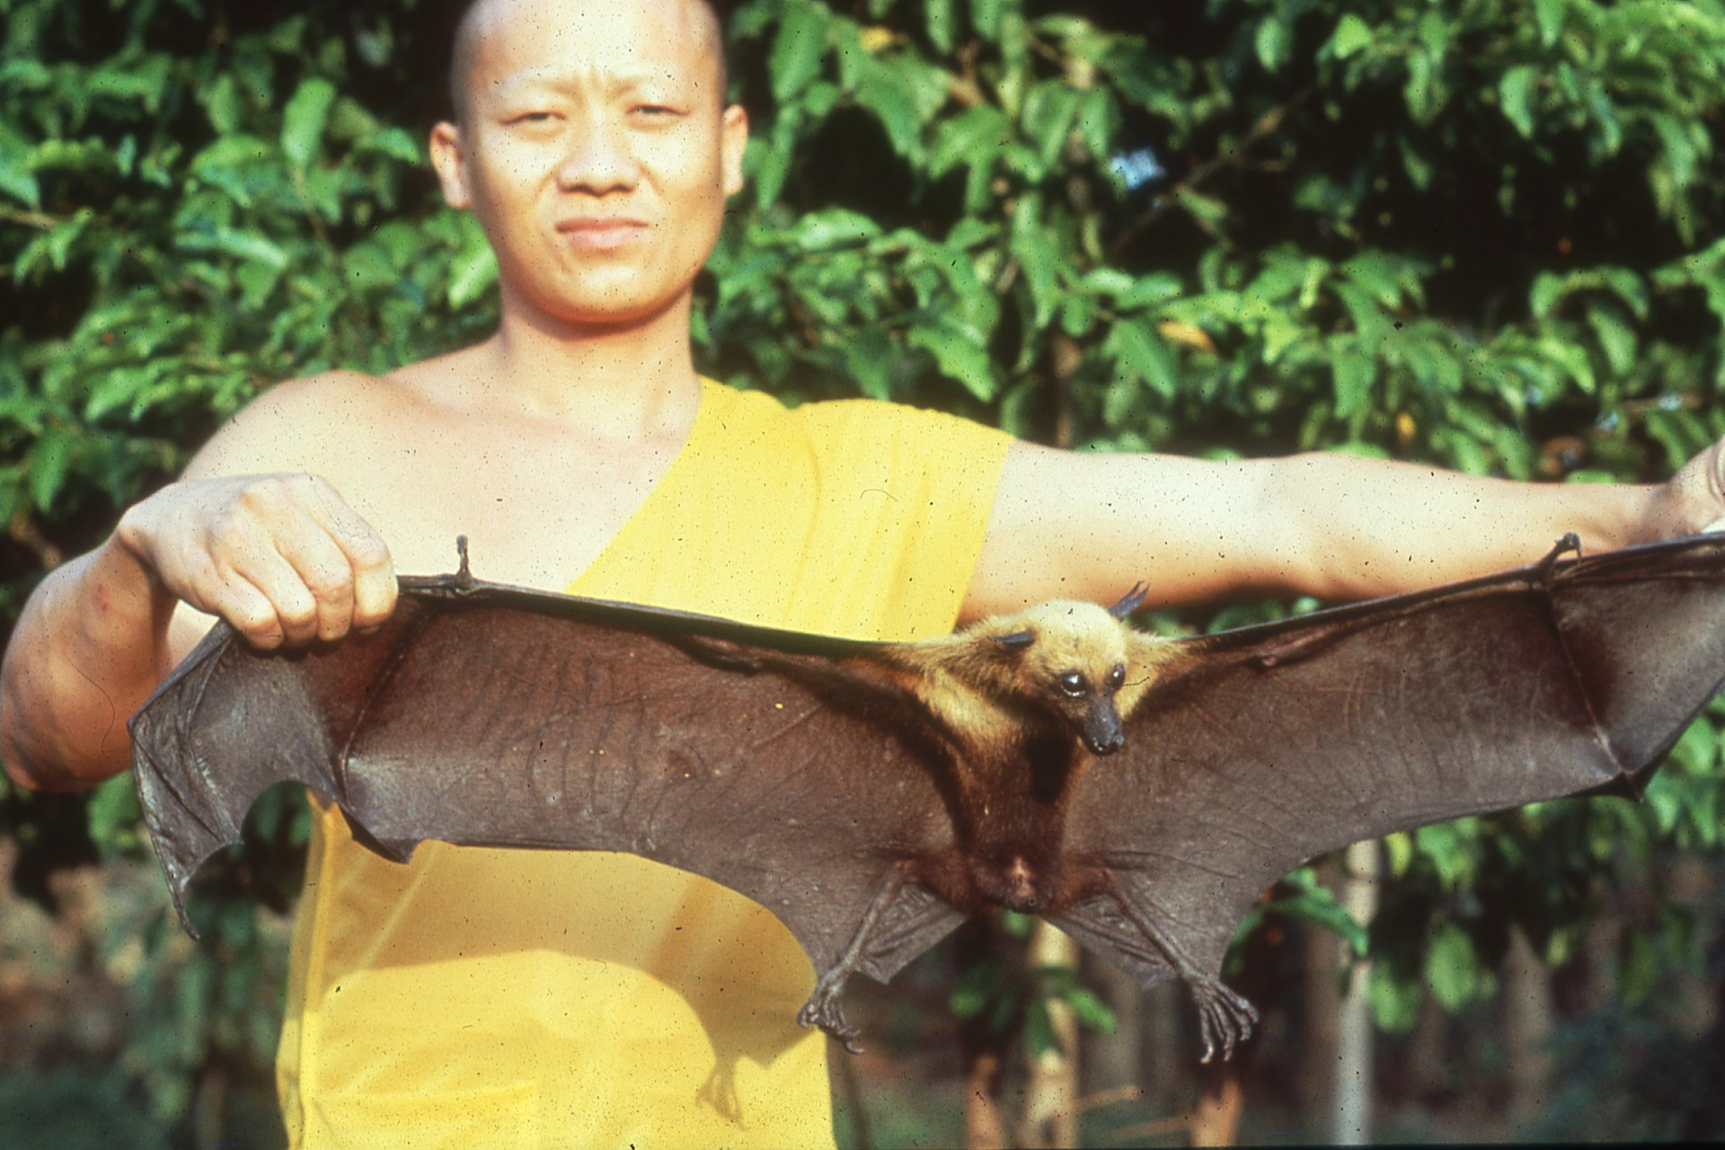
Notes:
While giant flying foxes have wingspans of 3 to 6 feet. Most people refer to bats as if they were all alike, yet these bats are less related to each other than a tiger is to a sea otter.

Slide 15
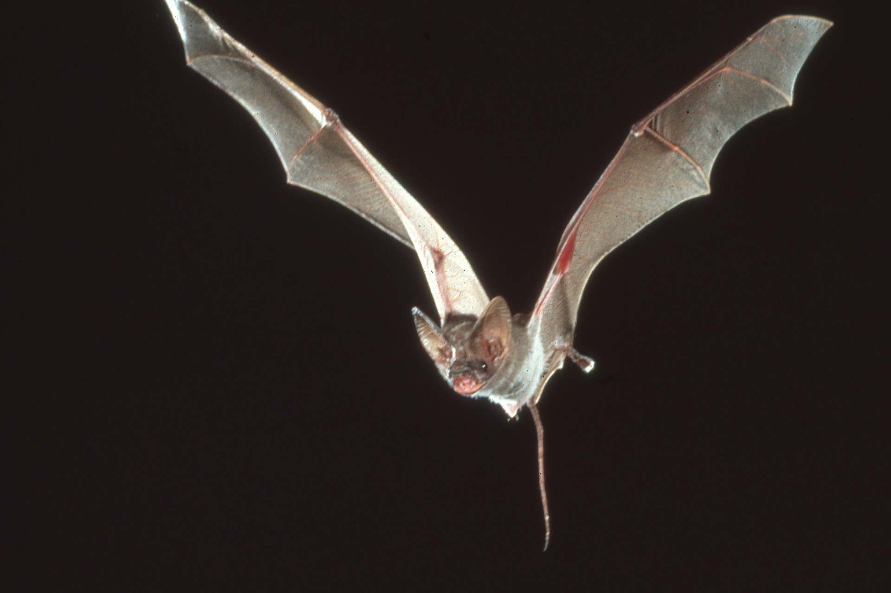
Notes:
In reality, even bats like this are more closely related to people than to the mice, which they are frequently compared.

Slide 16
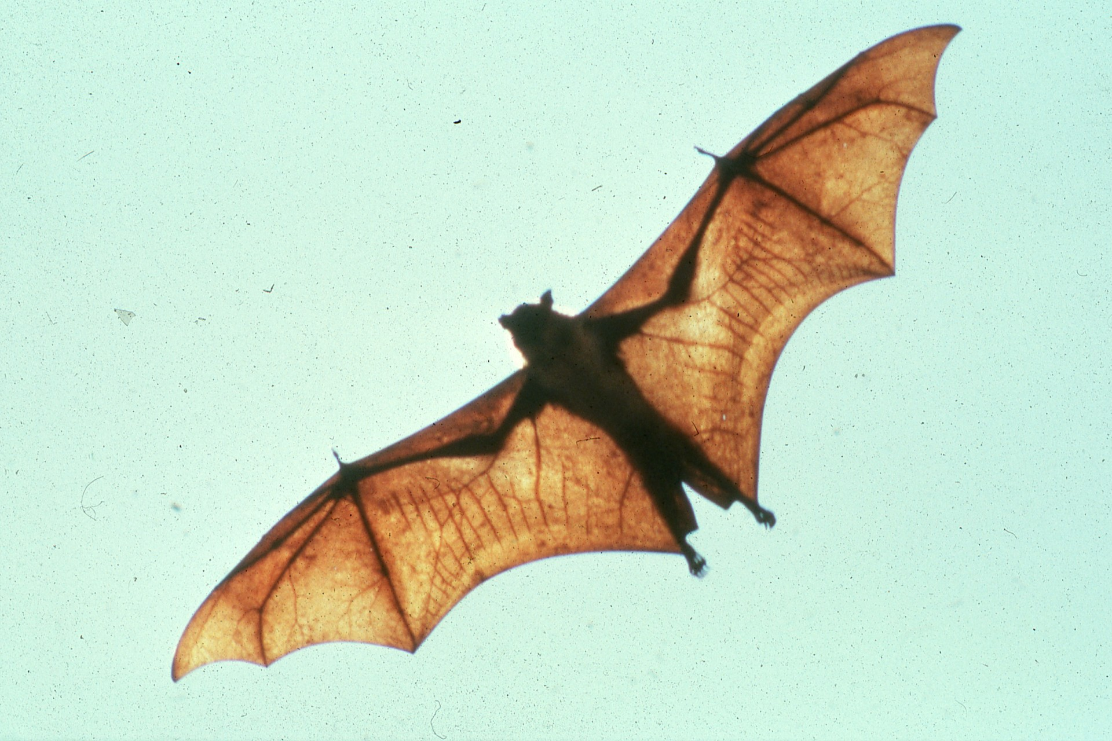
Notes:
Bats belong to the order Chiroptera, meaning “hand wing.” A bat’s wing is just an expanded hand, with long fingers connected by a thin, sturdy membrane.

Slide 17
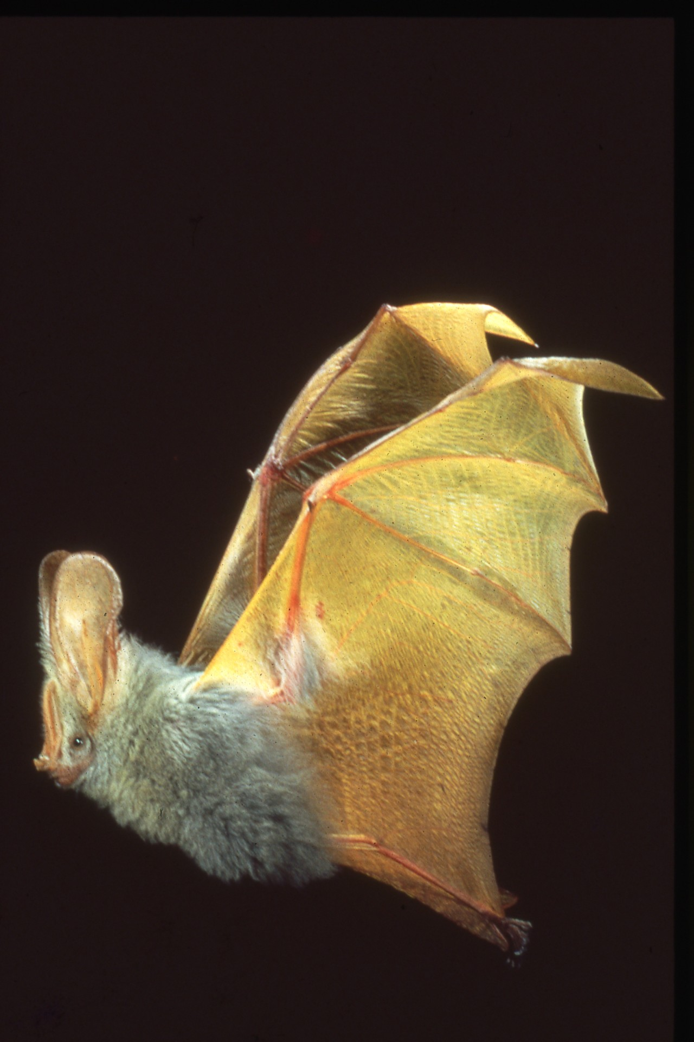
Notes:
Some, such as the yellow winged bat from Africa, are exceptionally colorful.

Slide 18
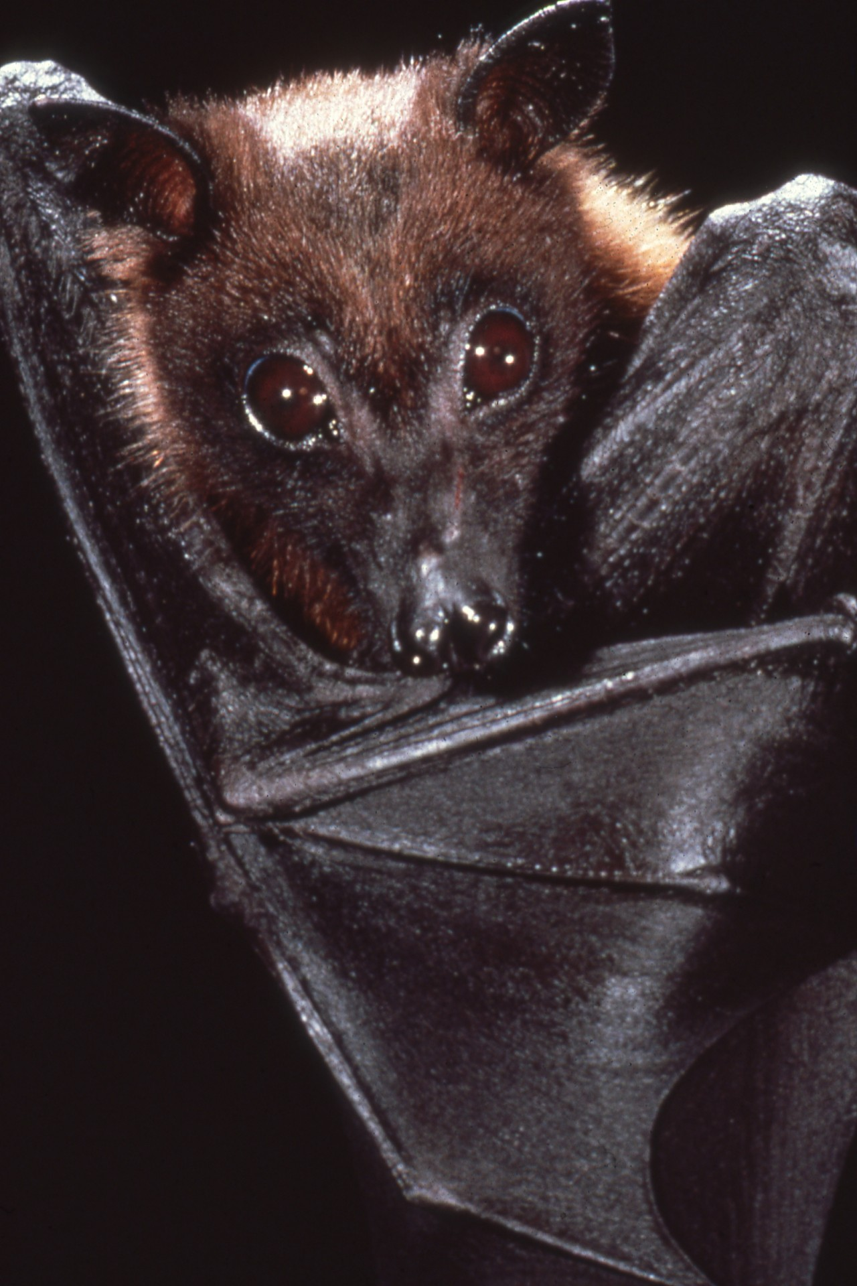
Notes:
Contrary to what most people think, bats are among the world’s most naturally gentle animals. Like dolphins, …

Slide 19
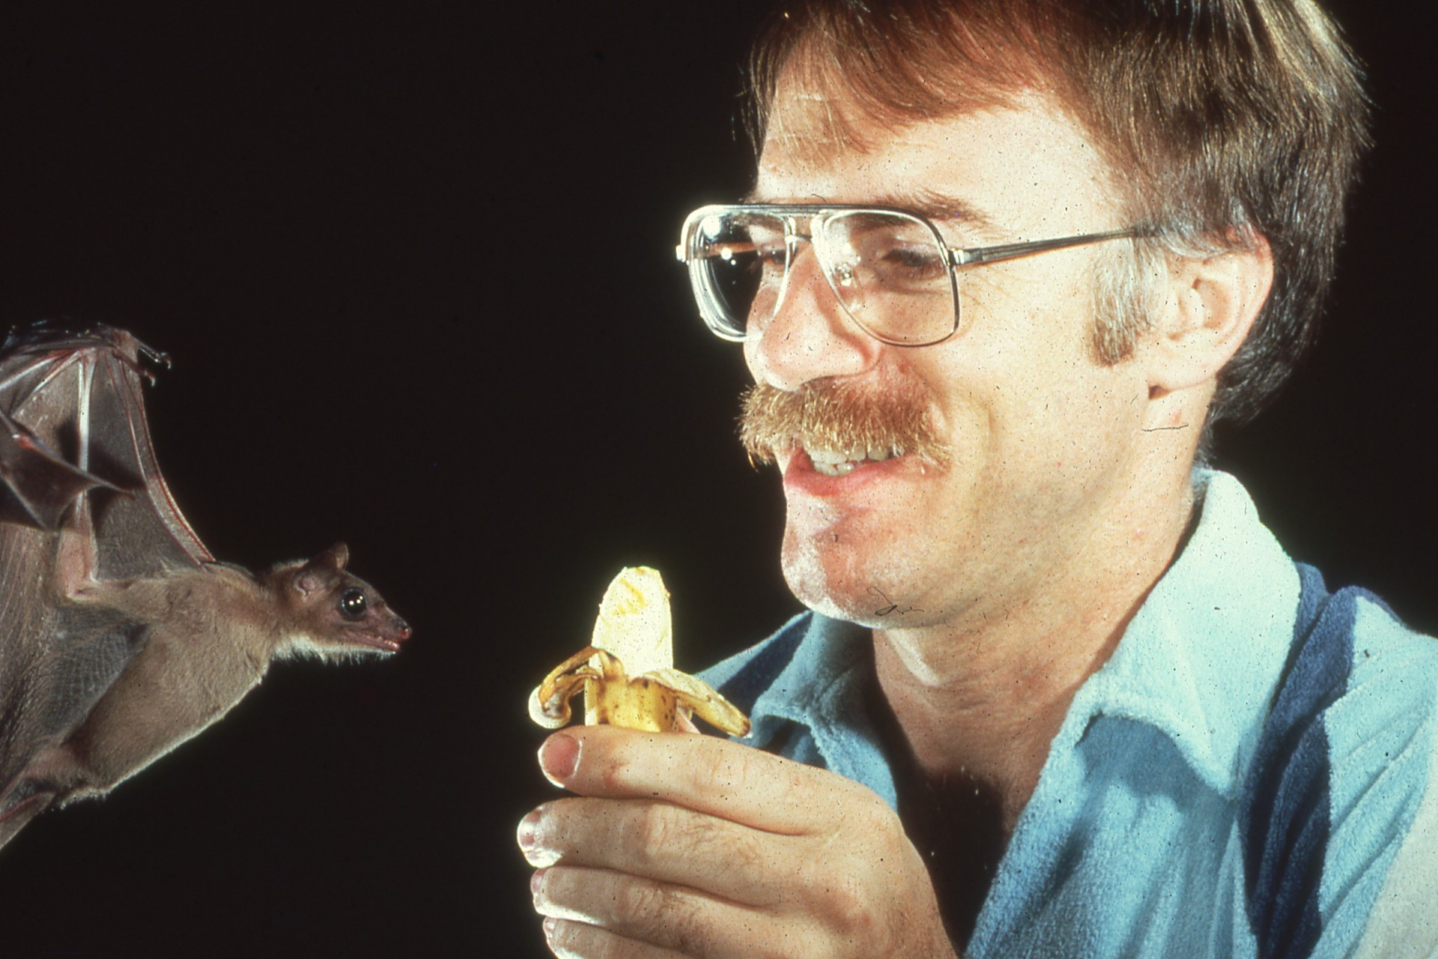
Notes:
Like dolphins, many are highly intelligent and easily trained, each with its own unique personality.

Slide 20
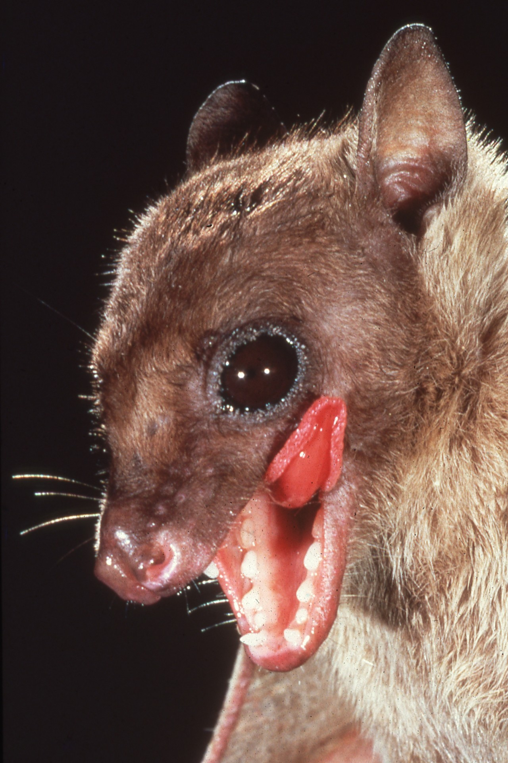
Notes:
Like dogs and cats, bats get excited at meal time. They certainly are not dirty or scary!

Slide 21
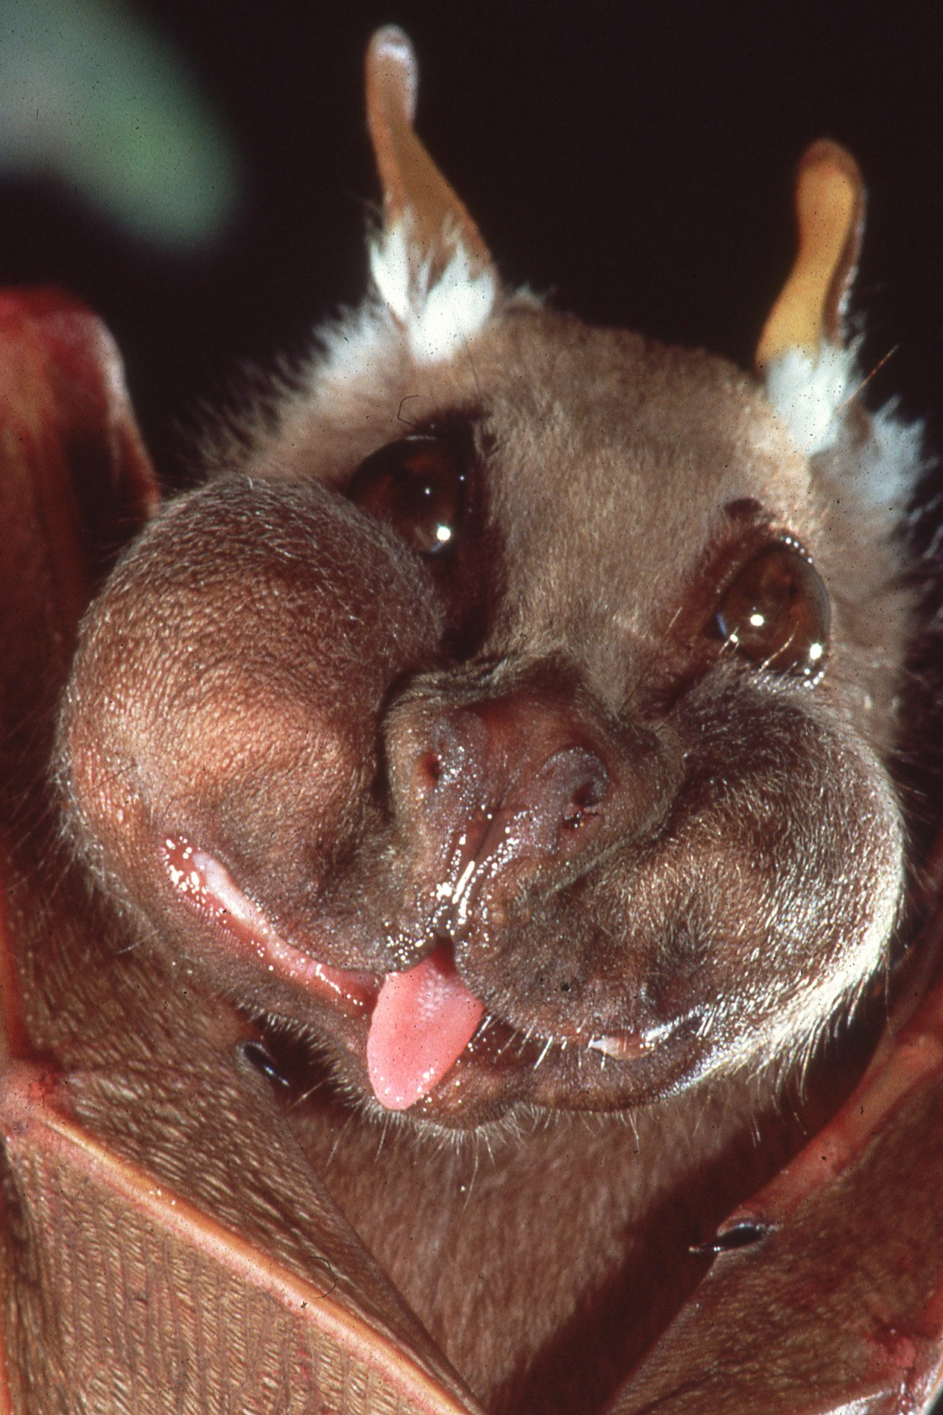
Notes:
And some are real characters. They do not become entangled in peoples’ hair. And frightening tales of bats as carriers of rabies and other dread diseases are grossly exaggerated.

Slide 22
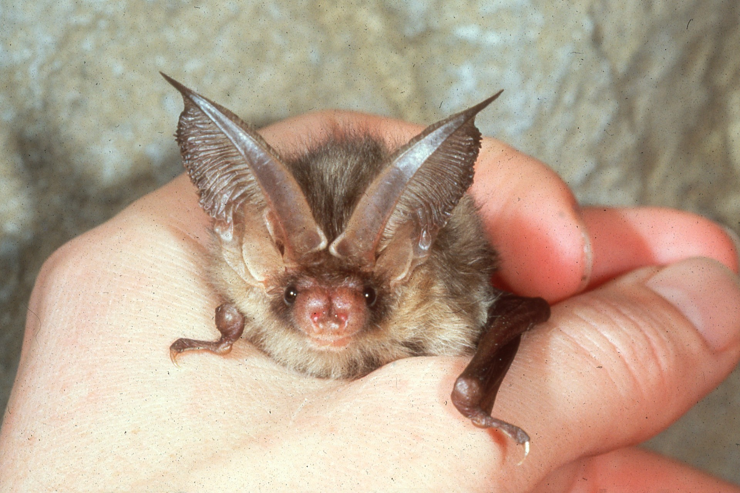
Notes:
Most bats are harmless and highly beneficial. Nevertheless, only experts should attempt to handle them, because any bat that you can catch is more likely than others to be sick.

Slide 23
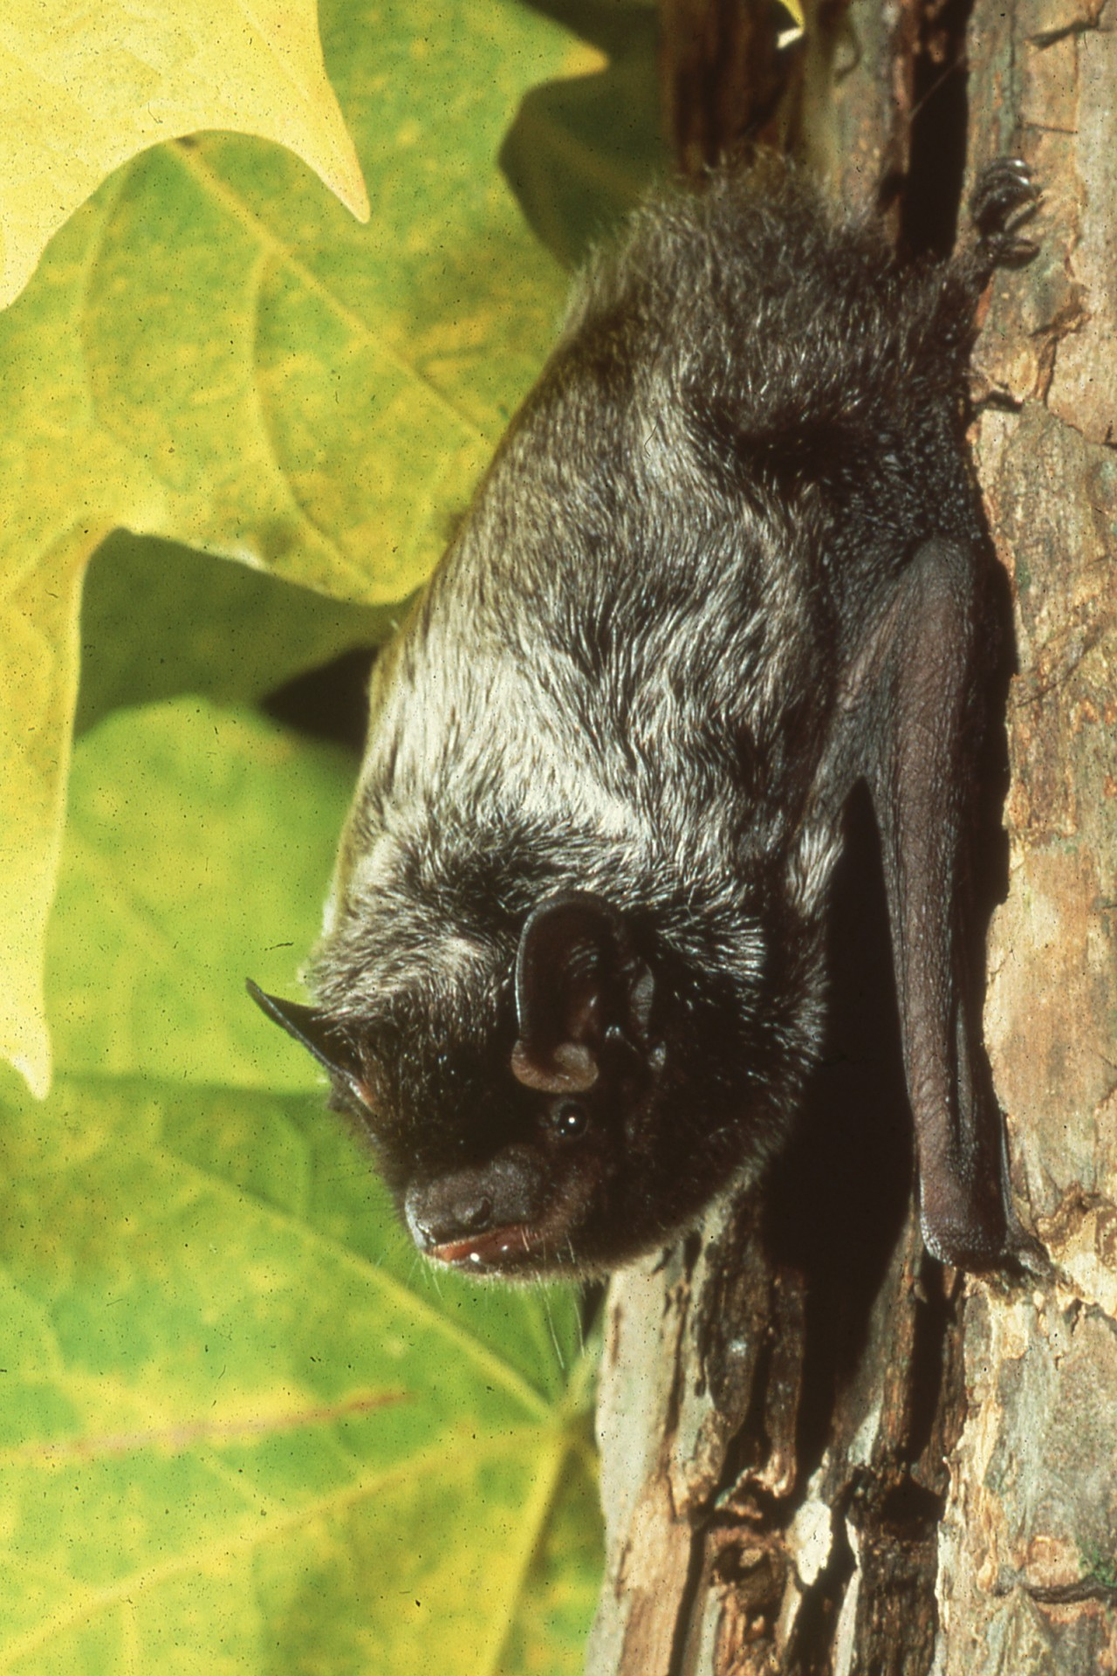
Notes:
When people are bitten, it is normally because they have picked up a grounded bat that bites in self-defense. Simply leave bats alone, and they are happy to return the favor.

Slide 24
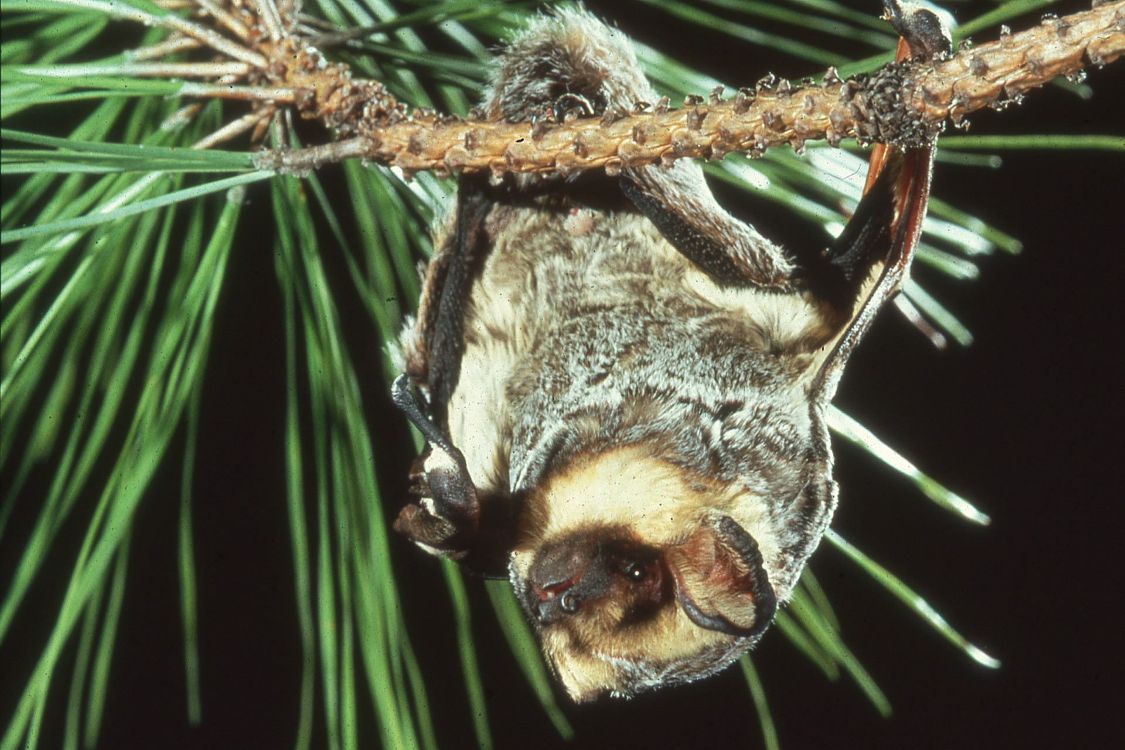
Notes:
Fewer than half of one percent of bats contract rabies, and even those individuals rarely become aggressive. Mortality statistics show that our own pet dogs are far more dangerous.

Slide 25
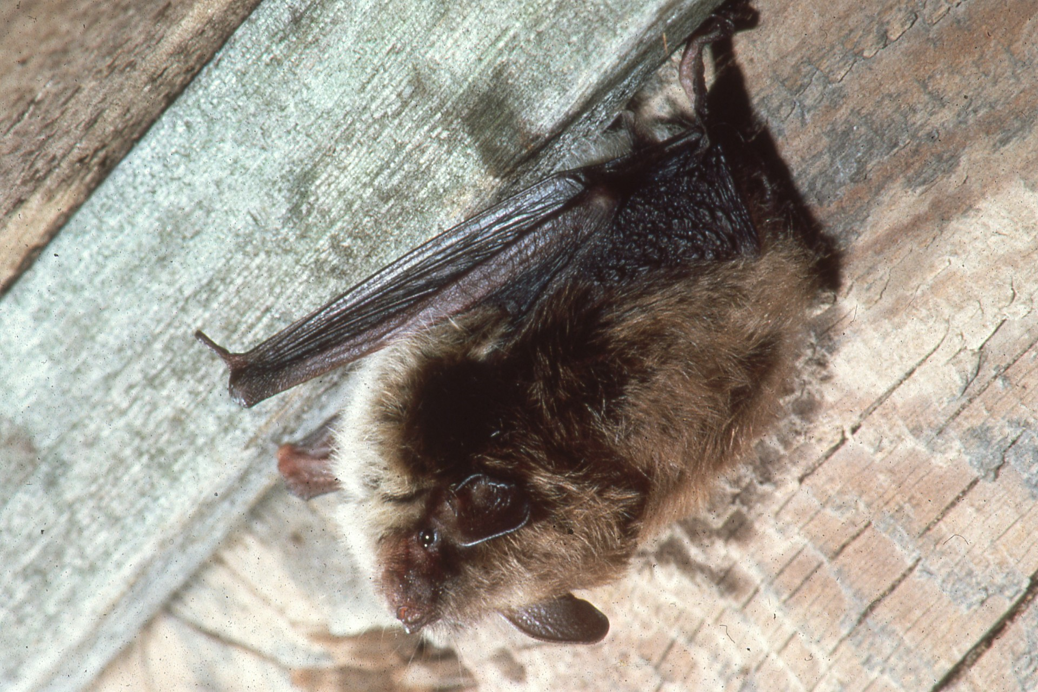
Notes:
Ironically, the most serious health hazards involving bats are those created when poisons are used to get rid of them.

Slide 26
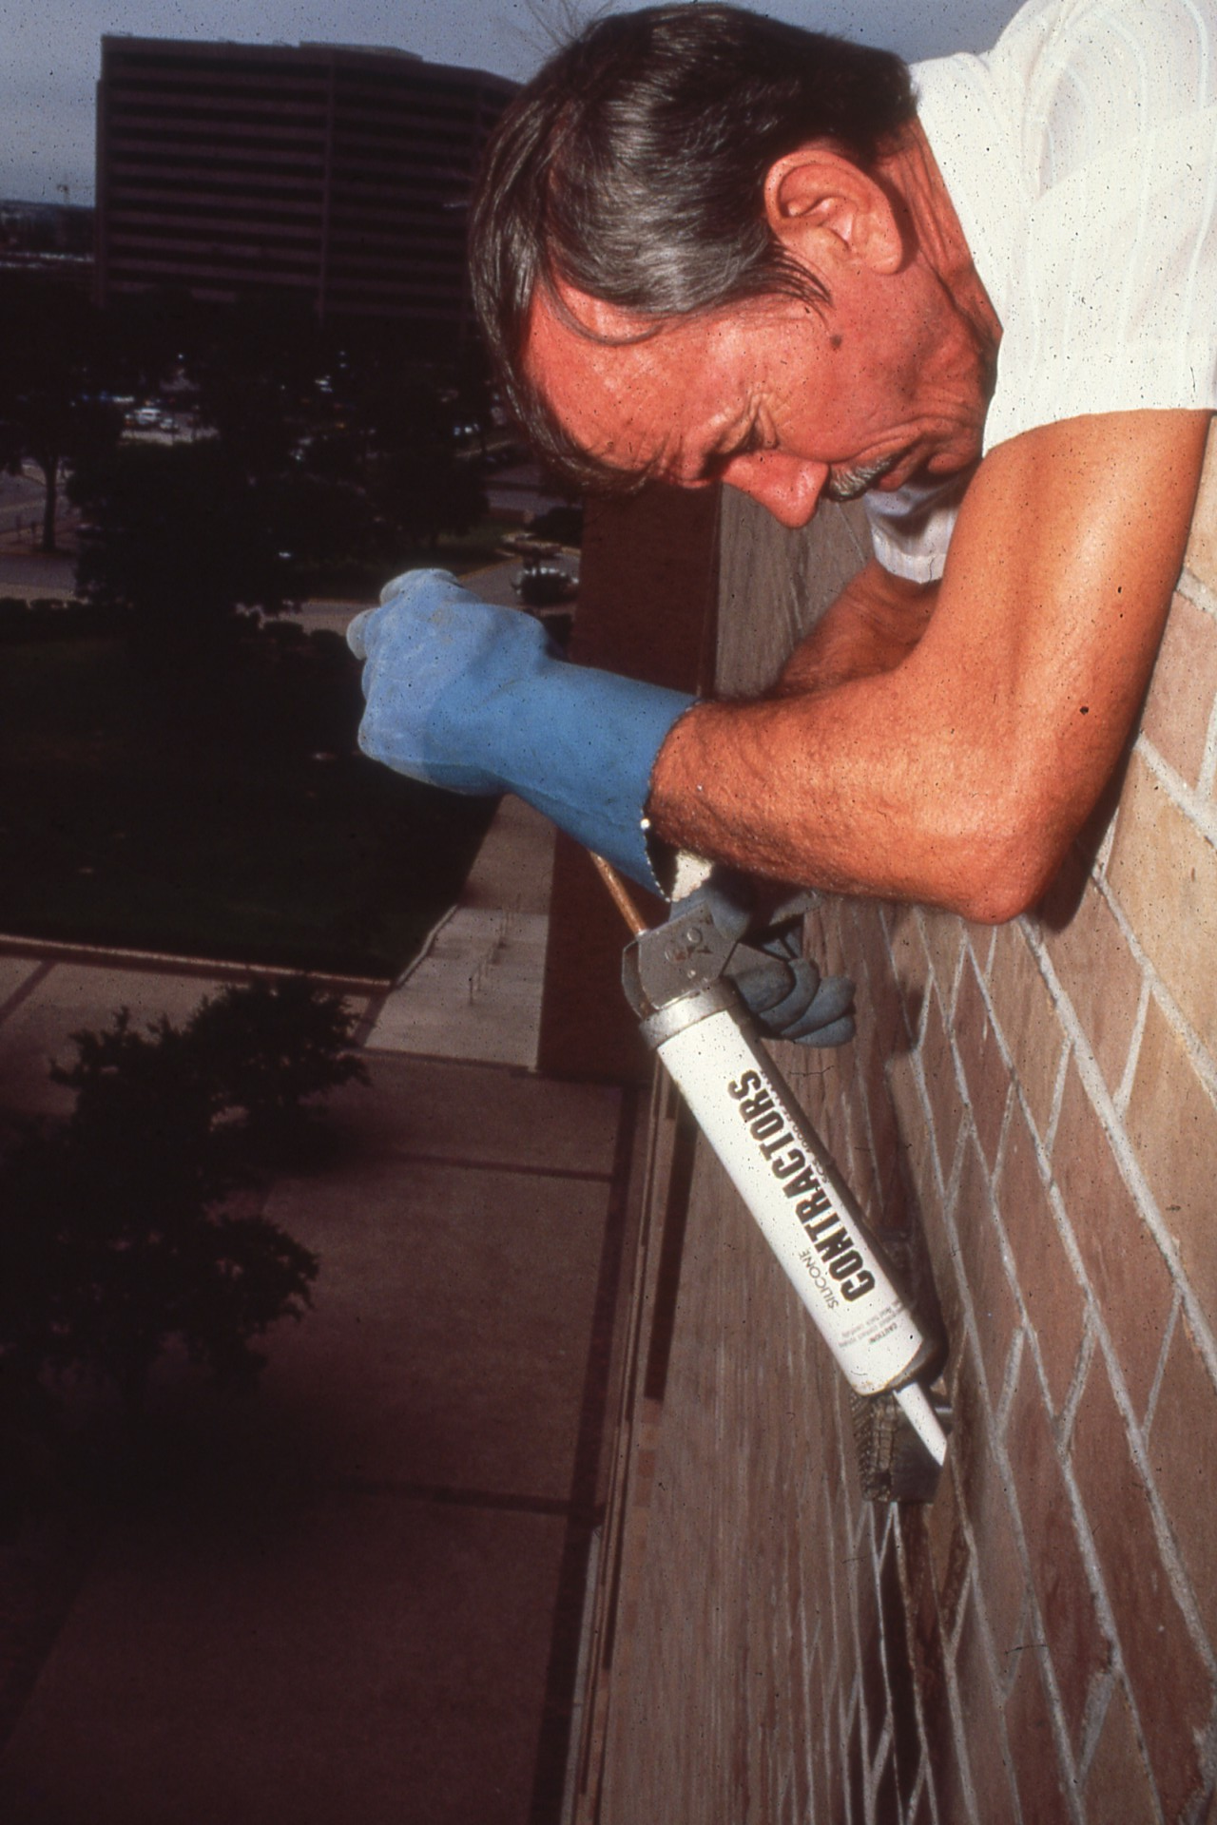
Notes:
The only safe, permanent way to evict unwanted bats is to exclude them by plugging entry holes after their twilight departure to feed.

Slide 27
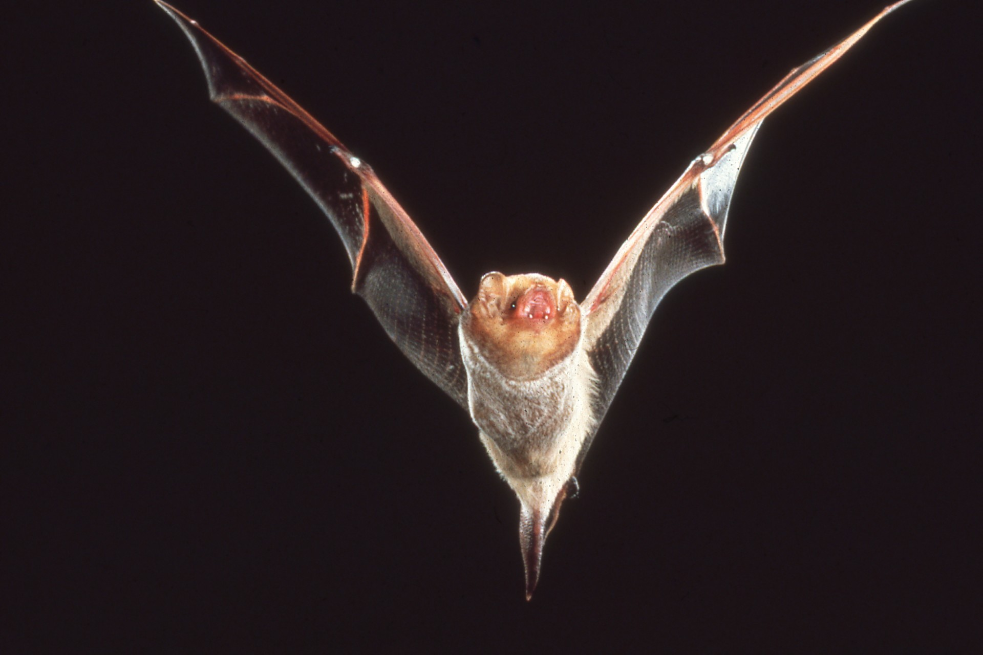
Notes:
Any bats trapped inside can be allowed to escape at sundown the next evening.

Slide 28
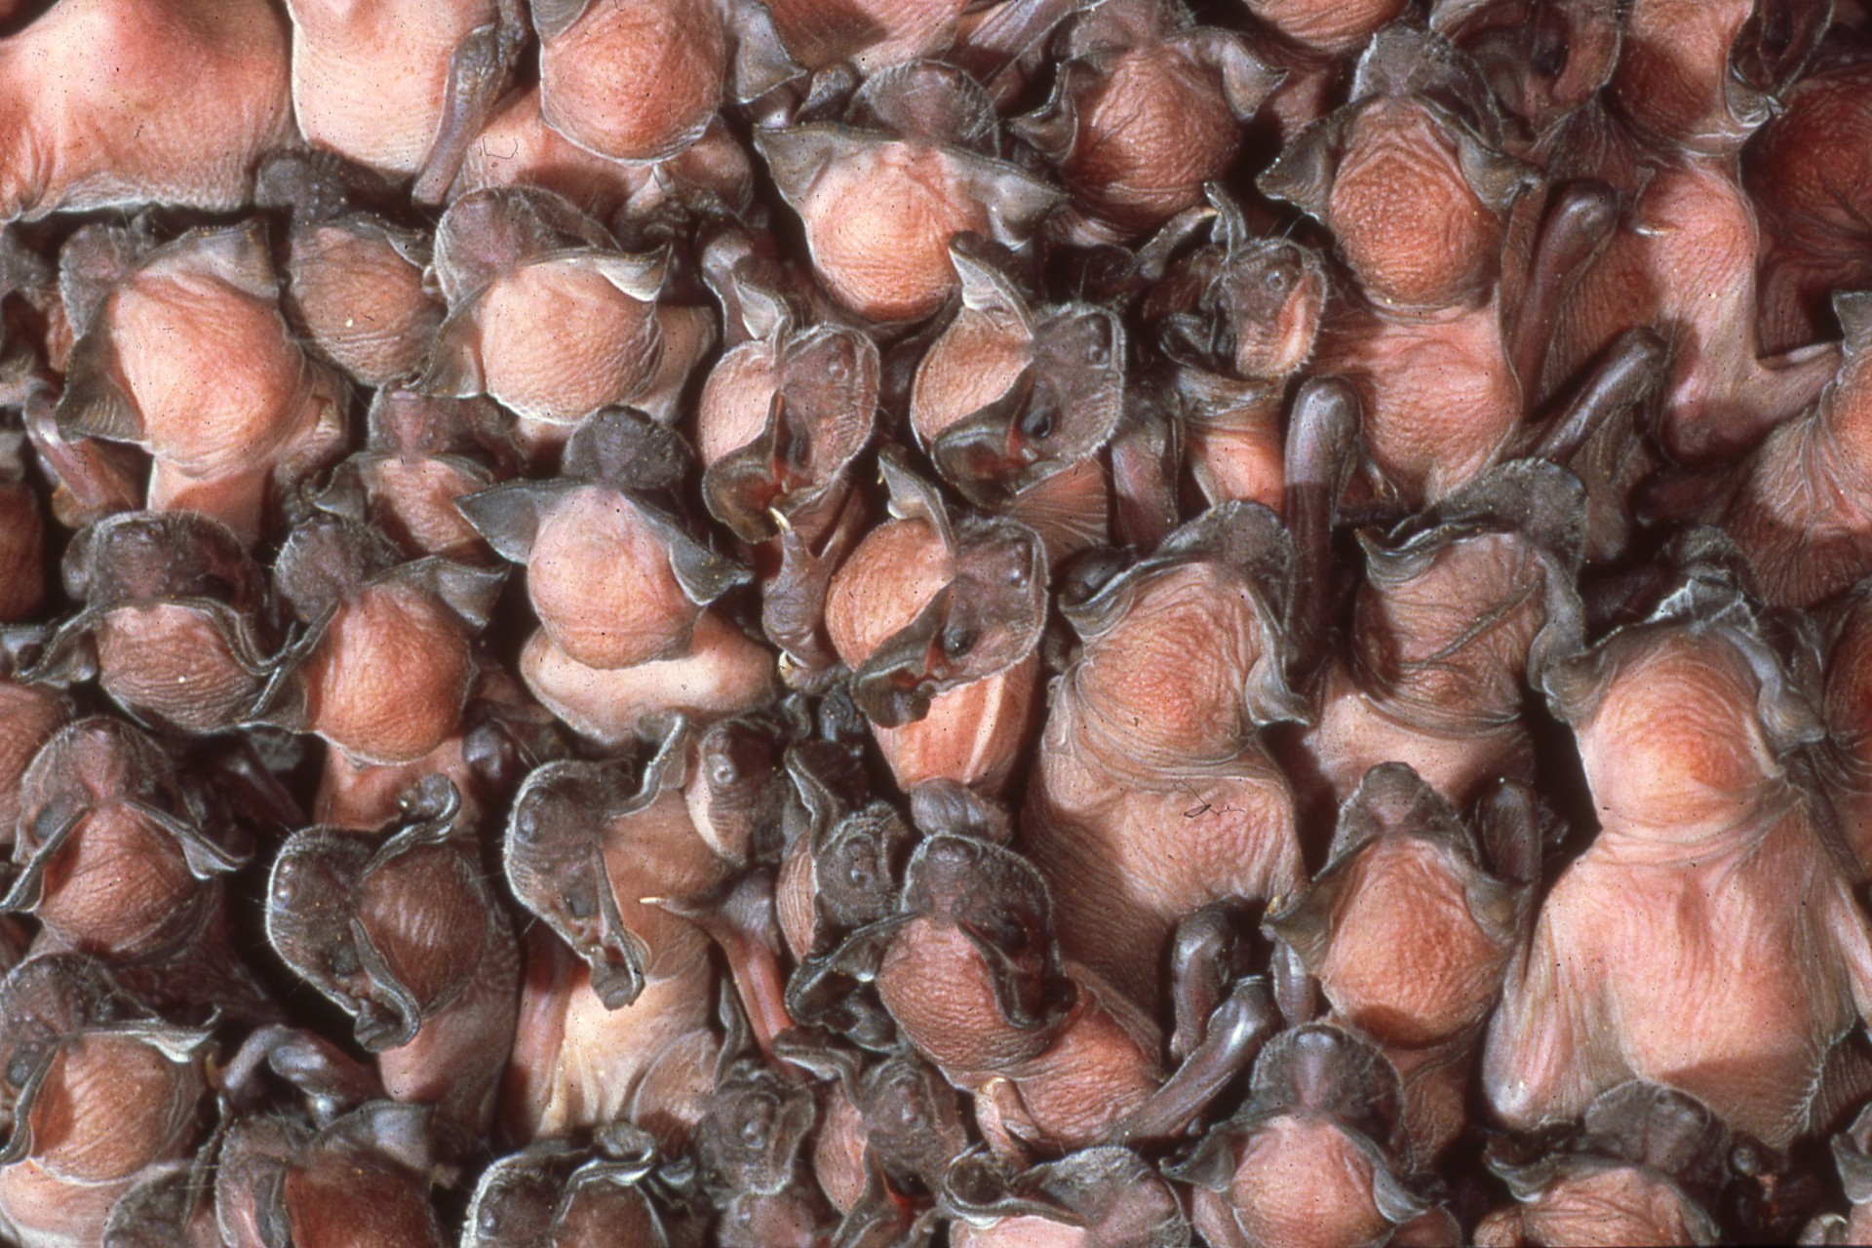
Notes:
Evictions should not be made from early to mid summer, when flightless young may be trapped and starved.

Slide 29
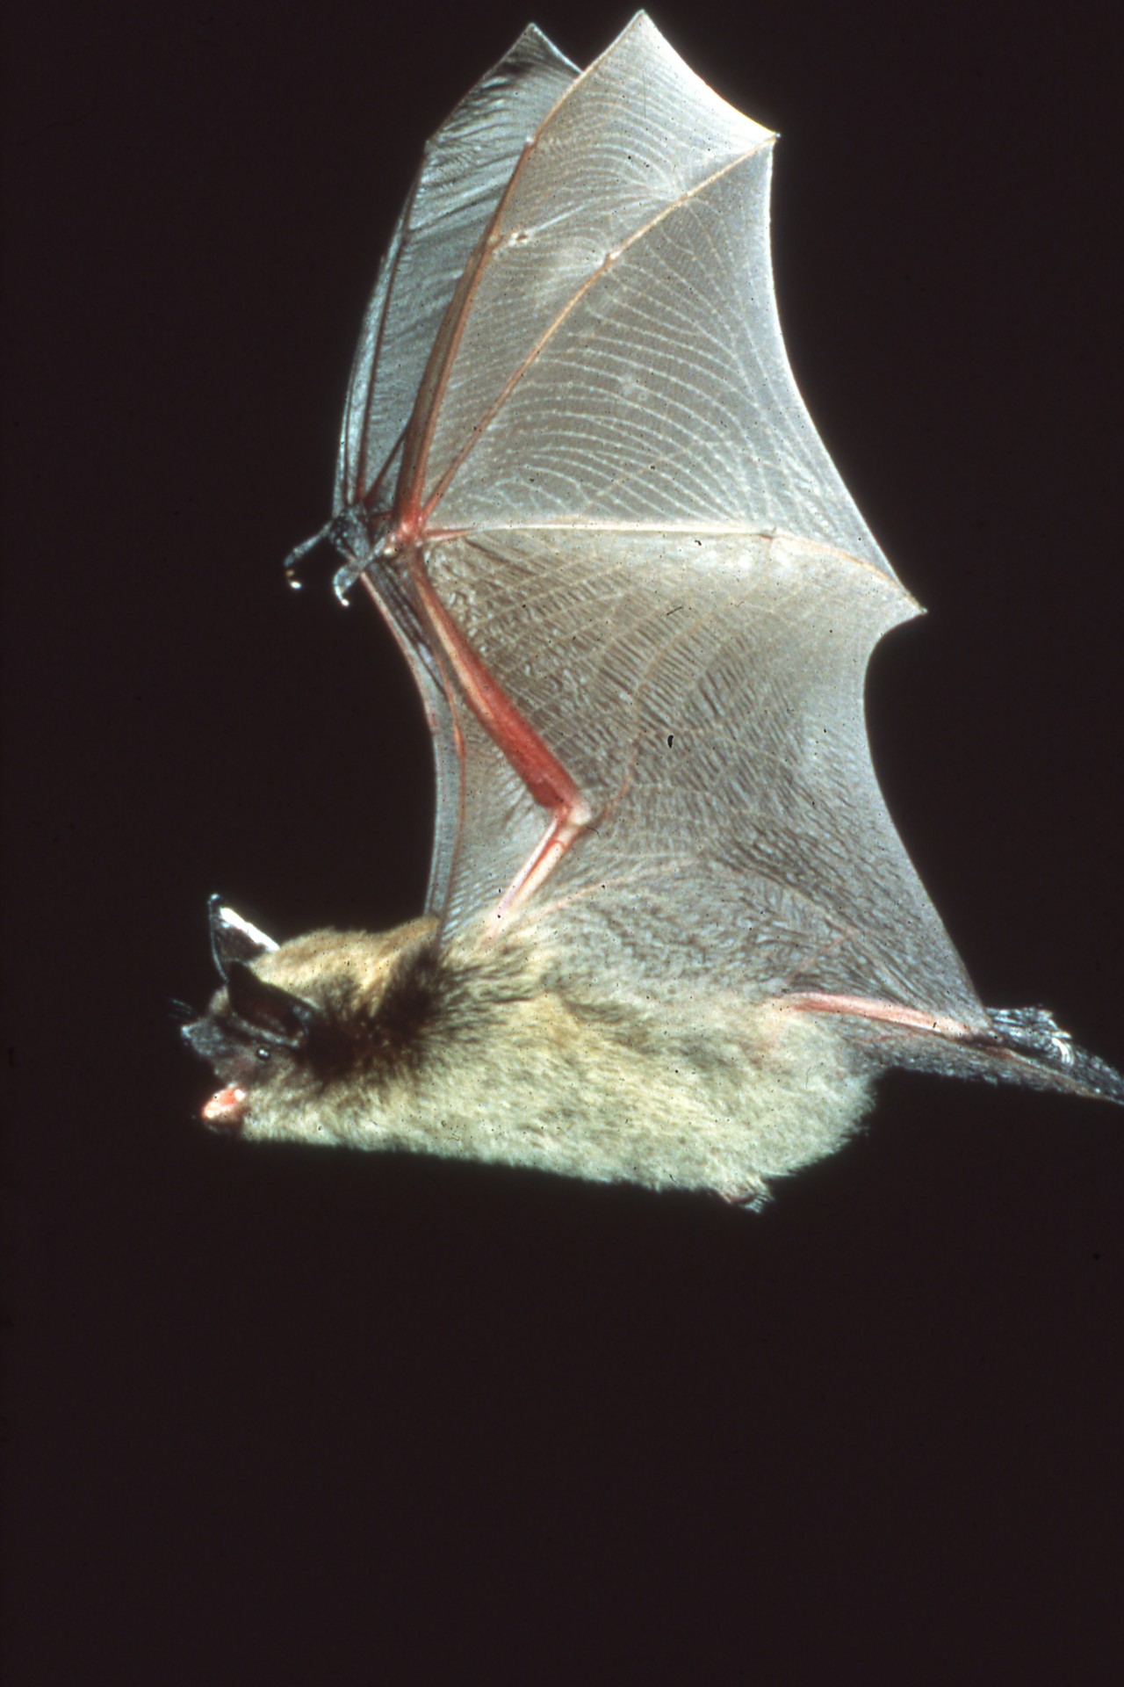
Notes:
Mouse-eared bats, the ones most commonly found in buildings in North America and Europe, can catch up to 500 or more insects, including many mosquitoes, in one hour. Seventy percent of bats are insectivorous, and they are the only major predator of night-flying insects.

Slide 30
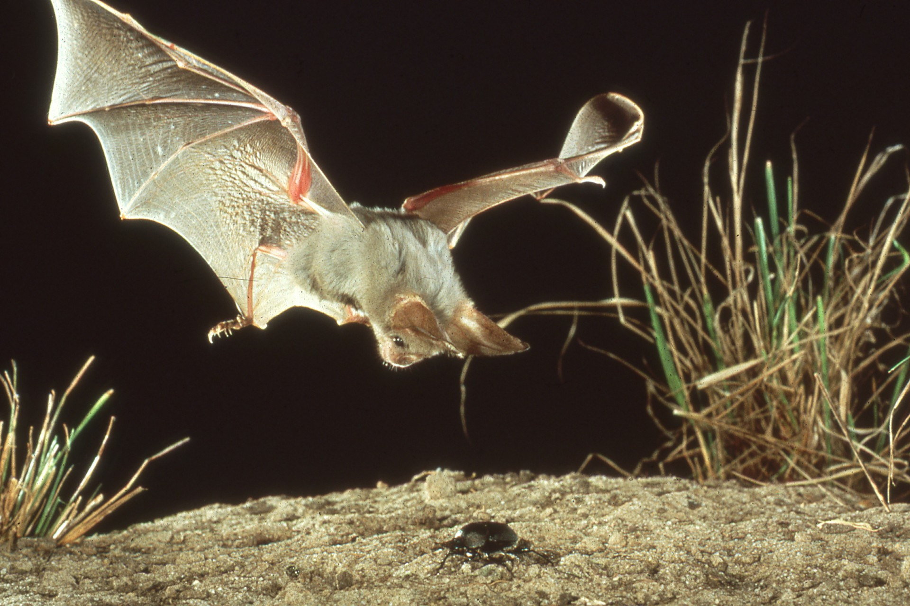
Notes:
This African heart-nosed bat is about to catch a beetle.

Slide 31
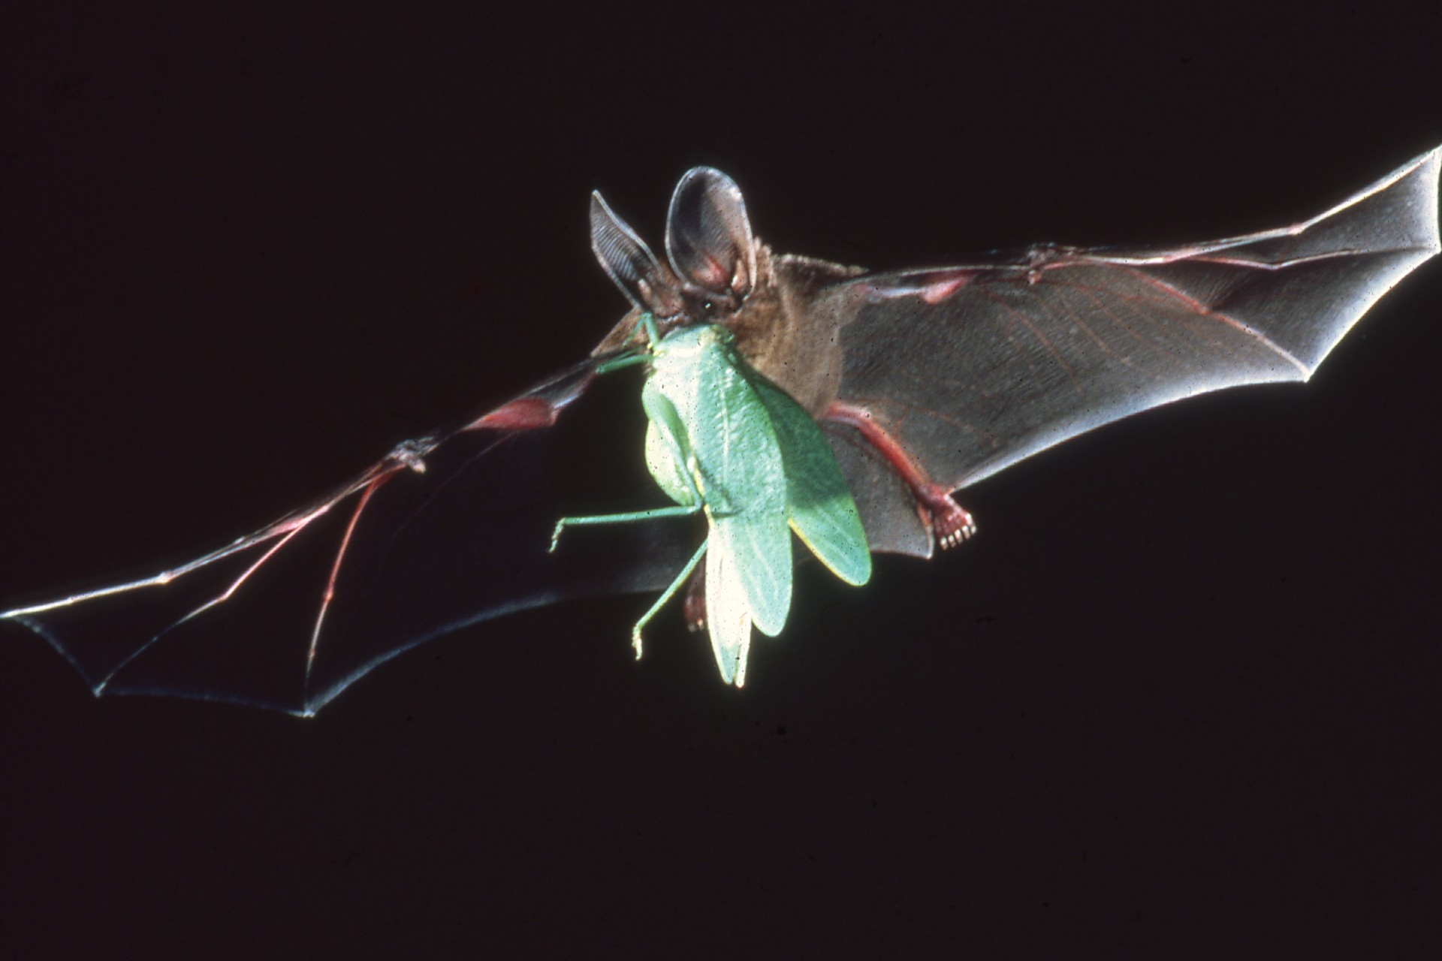
Notes:
And this American red bat is an important predator of moths, including agricultural pests such as cutworm and corn borer moths.

Slide 32
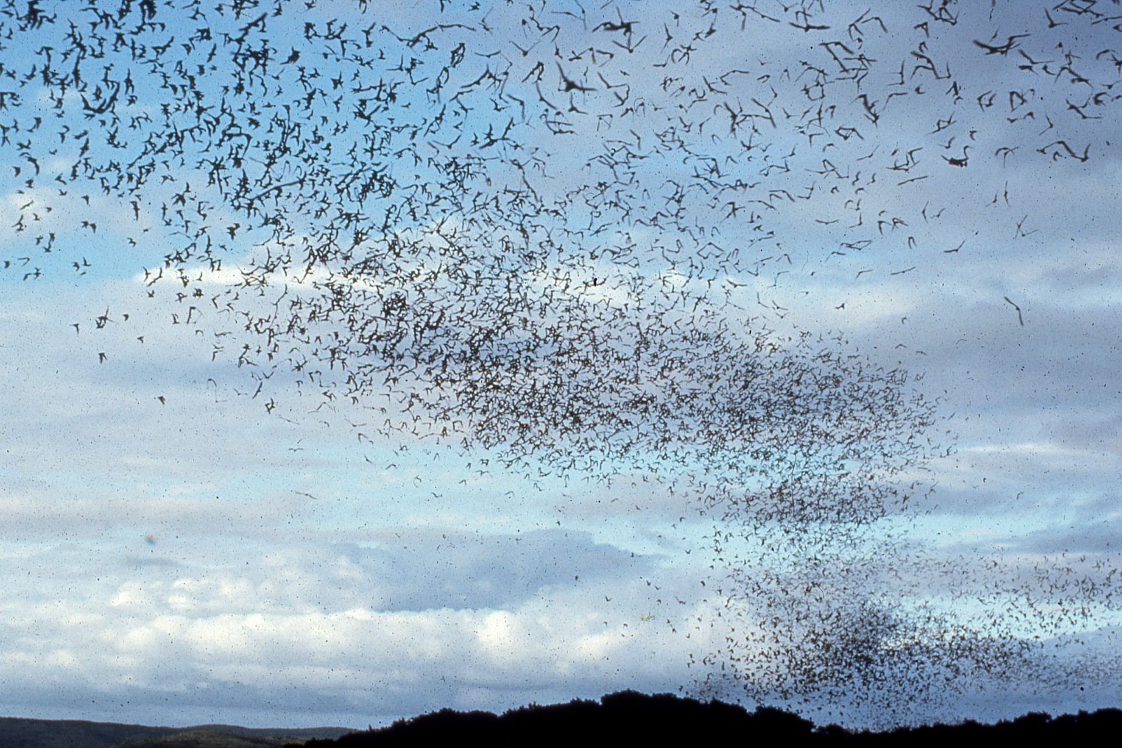
Notes:
One colony of twenty million free-tailed bats can eat more than a quarter million pounds of insects nightly. That’s the equivalent weight of 20 Asian elephants!

Slide 33
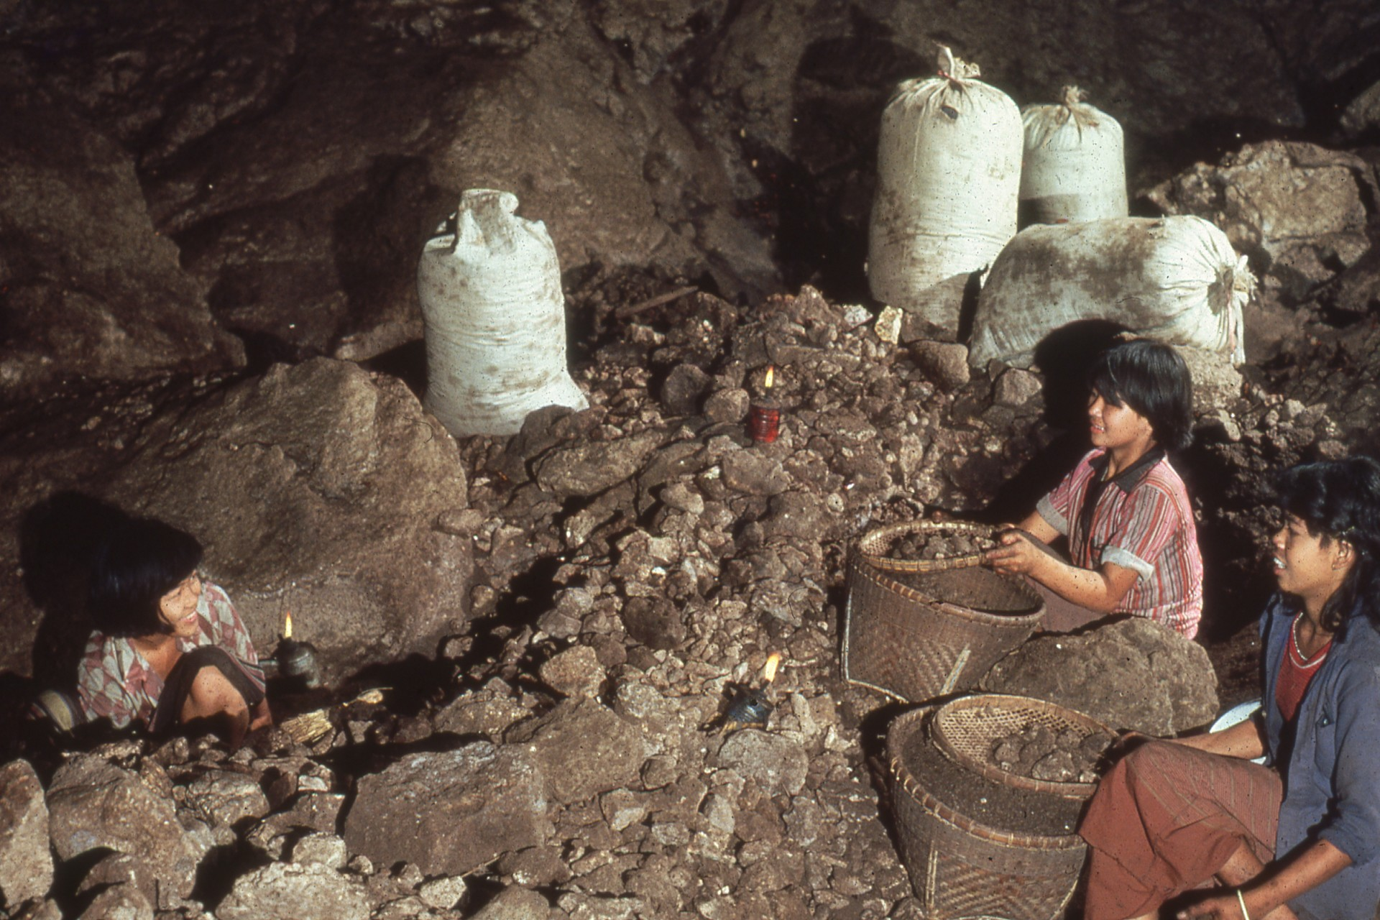
Notes:
Countless tons of droppings by insectivorous bats continue to be mined as one of the world’s most valuable fertilizers.

Slide 34
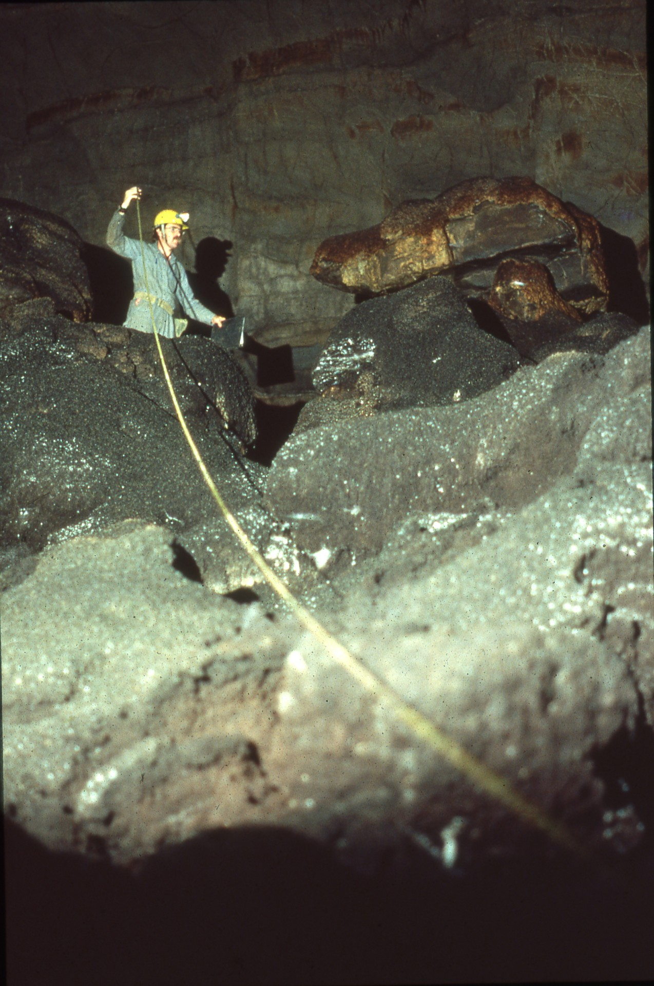
Notes:
In the United States, guano from a single cave sold for more than six million dollars. Where large colonies have been protected, sales continue.

Slide 35
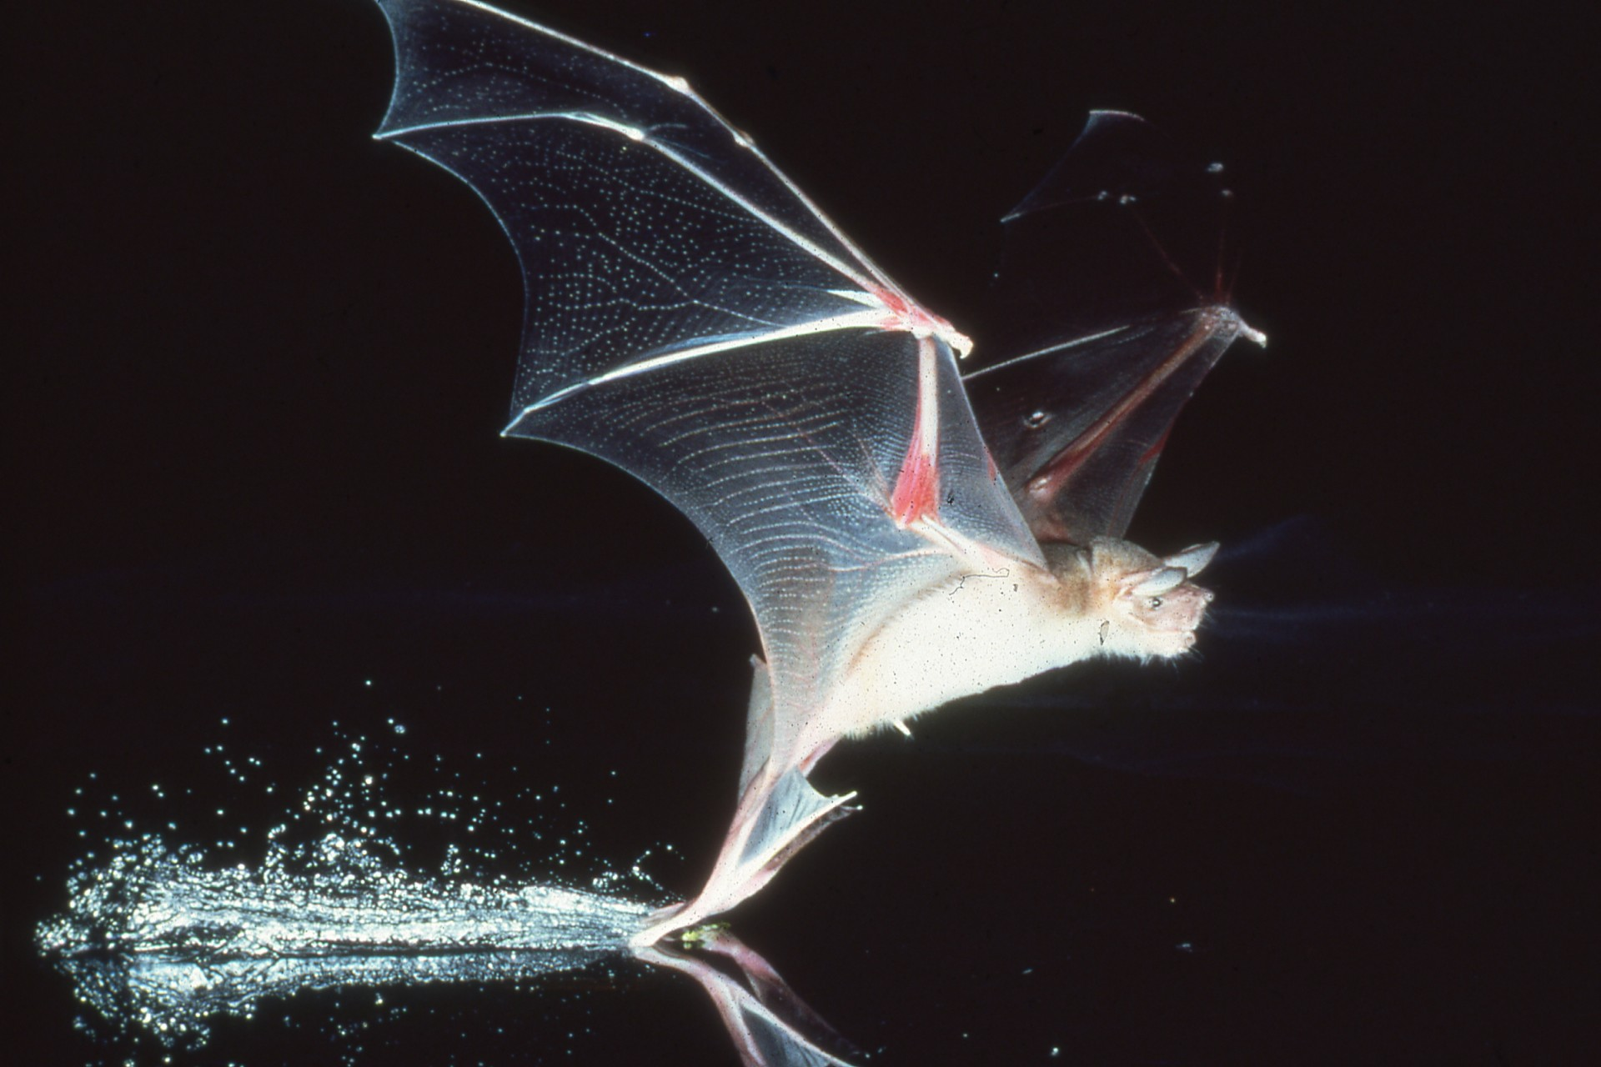
Notes:
A few bats are carnivores. Some use their large feet and claws to catch minnows.

Slide 36
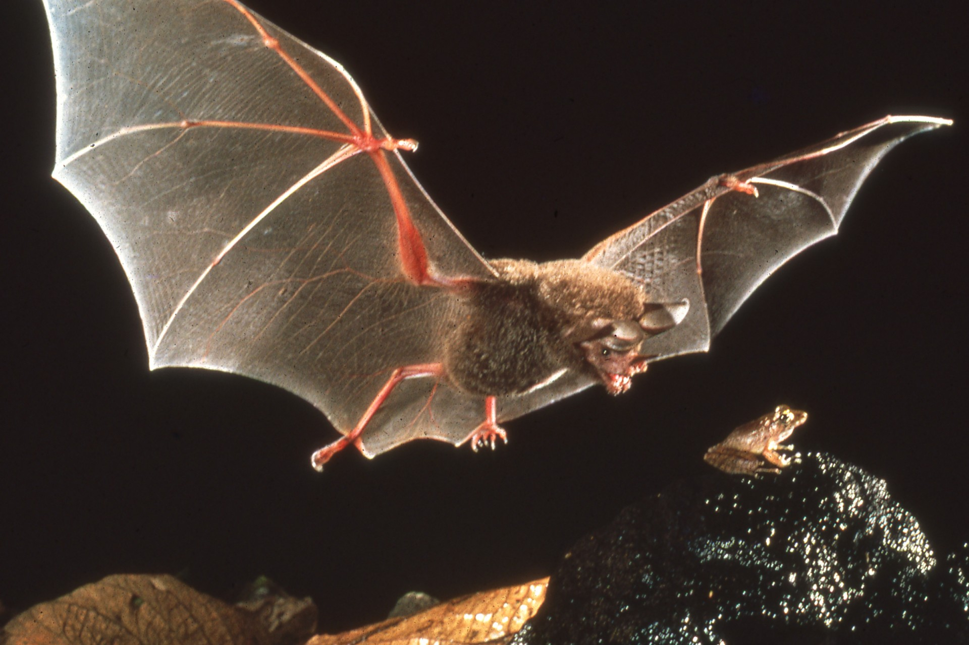
Notes:
Others even catch frogs. These bats use the frogs’ mating calls to identify and locate their prey.

Slide 37
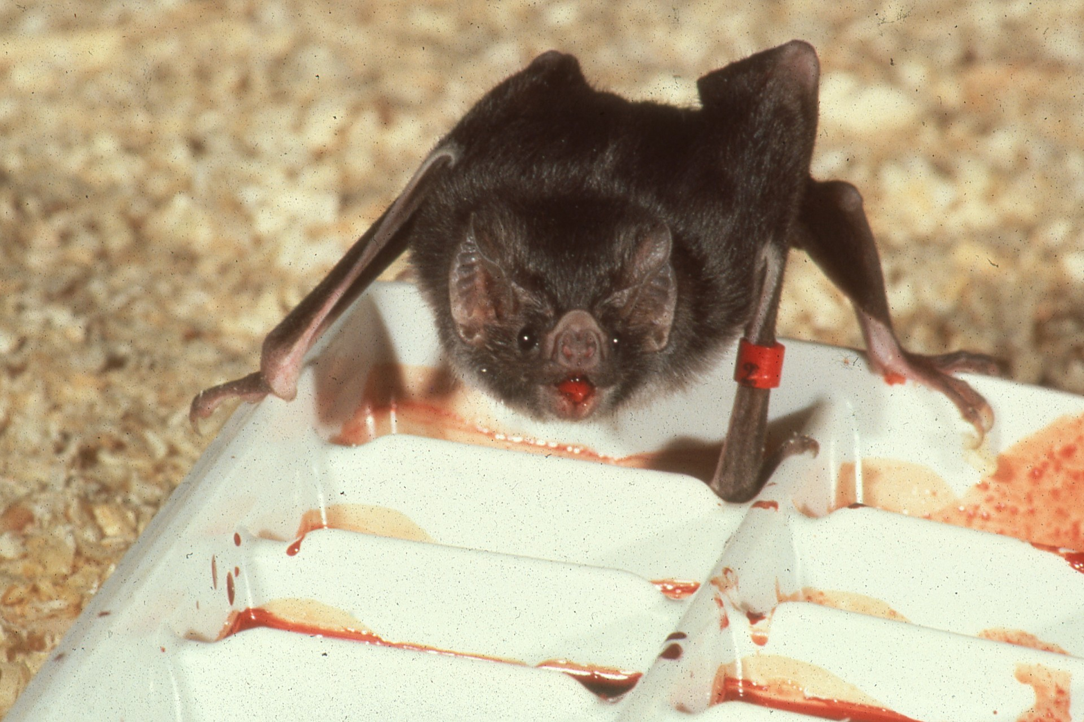
Notes:
Only three of nearly a thousand bat species eat blood, and these live only in parts of Latin America.

Slide 38
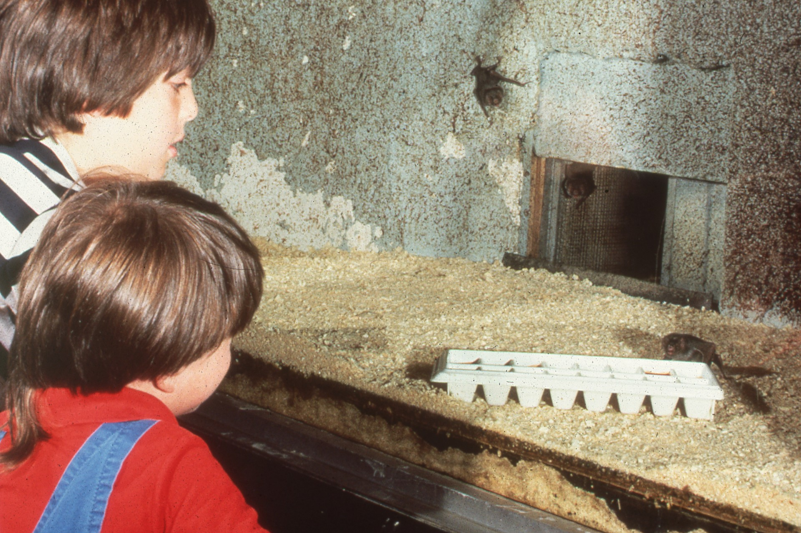
Notes:
But zoos, the news media, and even natural history books often emphasize them, as though they were typical. This bias leads many people to equate bats with vampires.

Slide 39
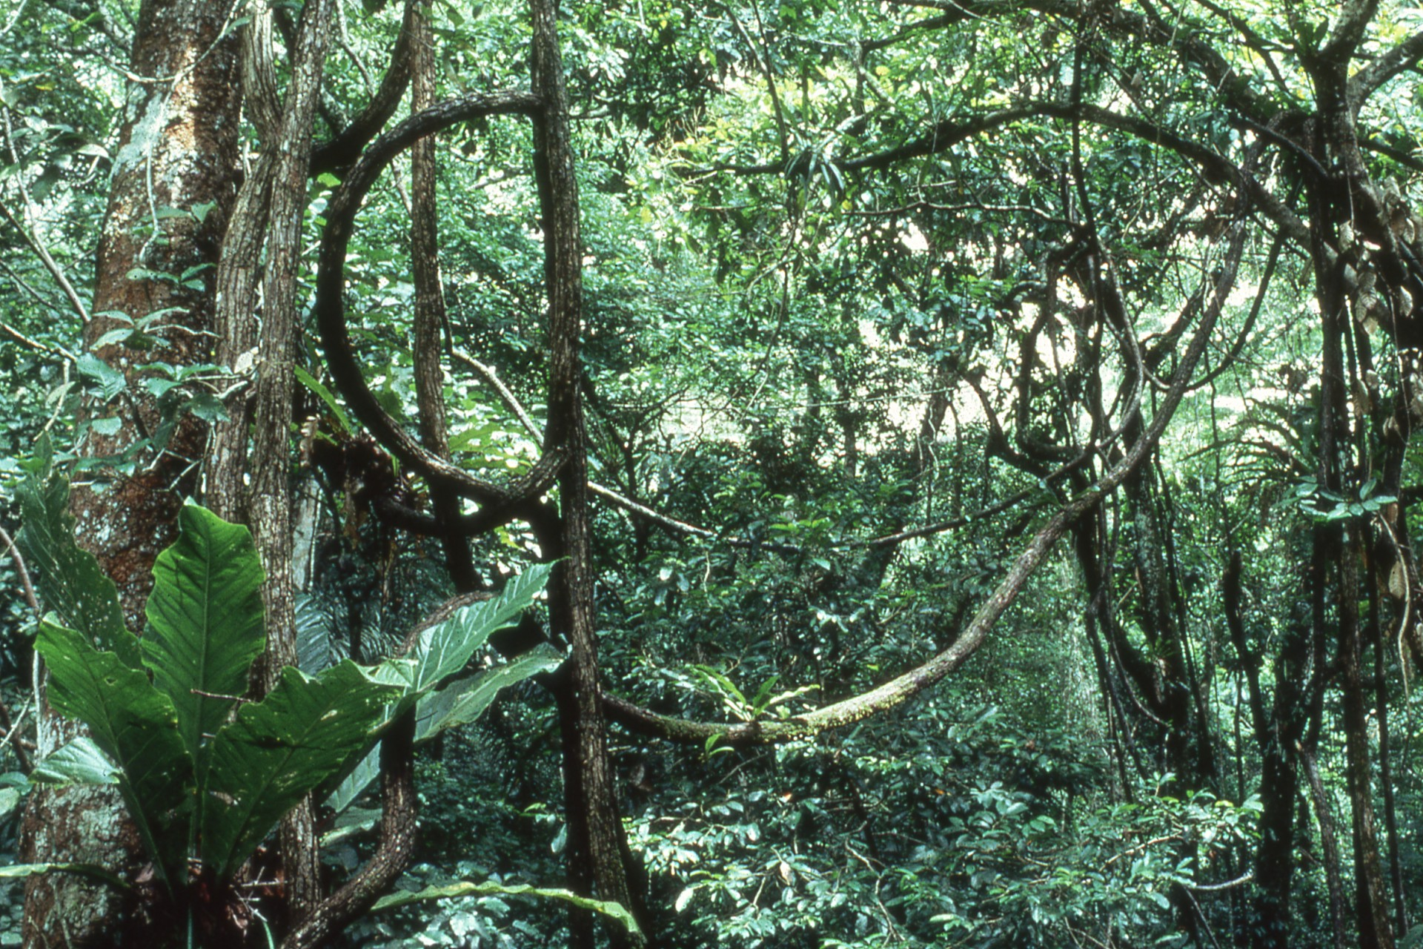
Notes:
In truth, even in the rainforests where vampires live, the vast majority of bats are extremely beneficial. So much so, that these forests might not be able to survive without them.

Slide 40
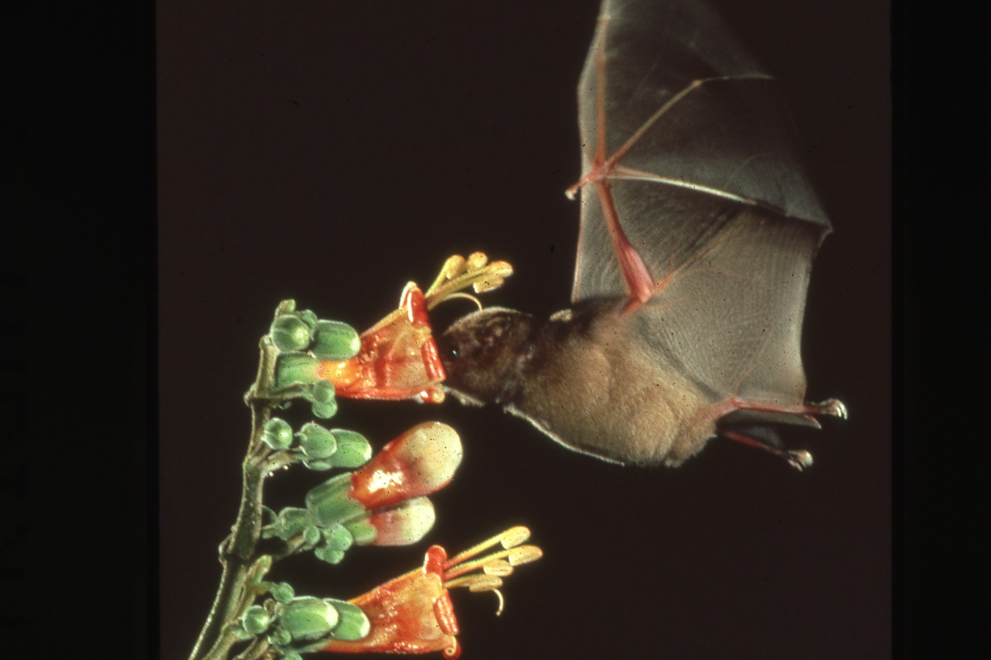
Notes:
Hundreds of kinds of fruit and nectarine bats pollinate flowers and disperse seeds.

Slide 41
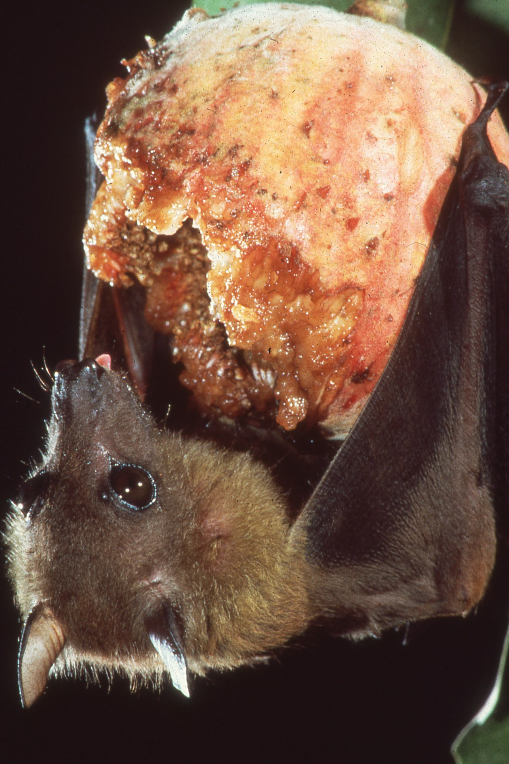
Notes:
Their activities are vital to rainforests and to many of the world’s most economically important plants.

Slide 42
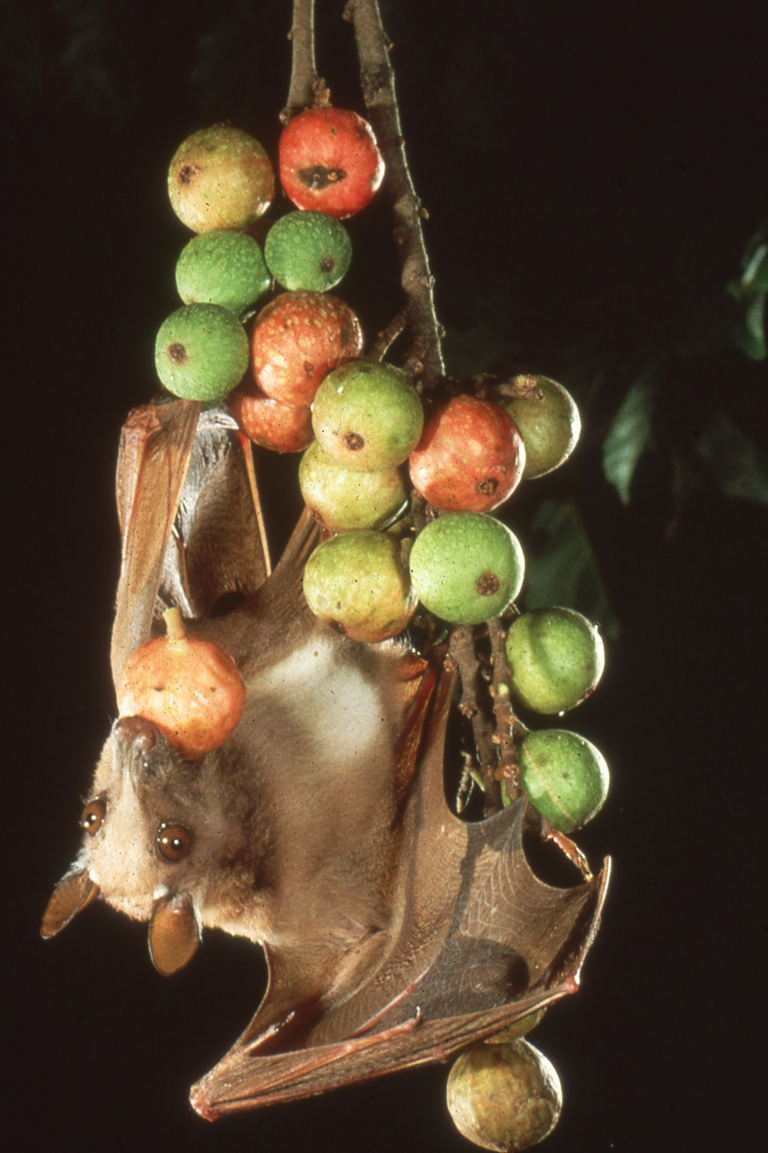
Notes:
Over a period of several nights, bats may carry more than a ton of seeds from a single wild fig tree. This dramatically increases the number of seedlings that will survive in new locations.

Slide 43
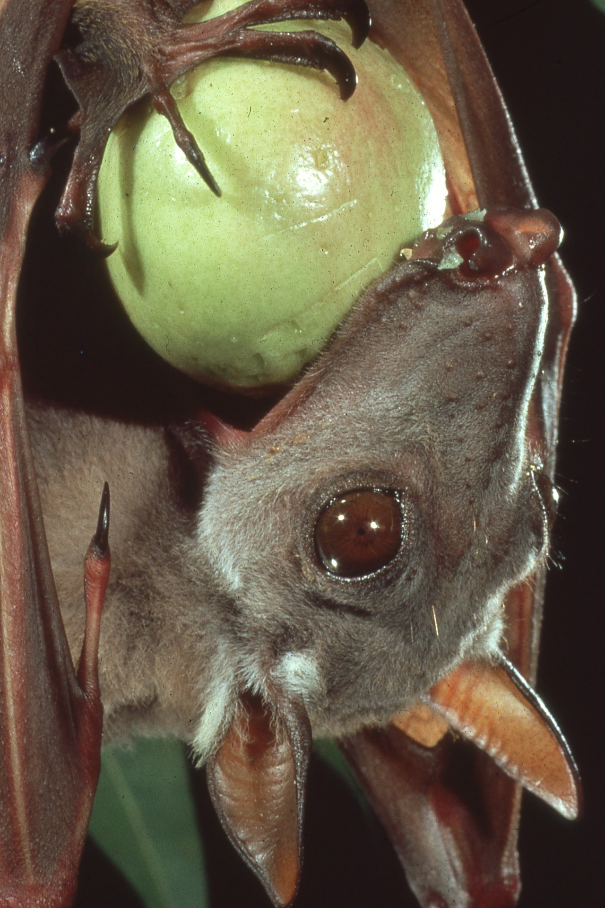
Notes:
Even when fruit is eaten at the tree, bats still are exceptionally efficient seed dispersers.

Slide 44
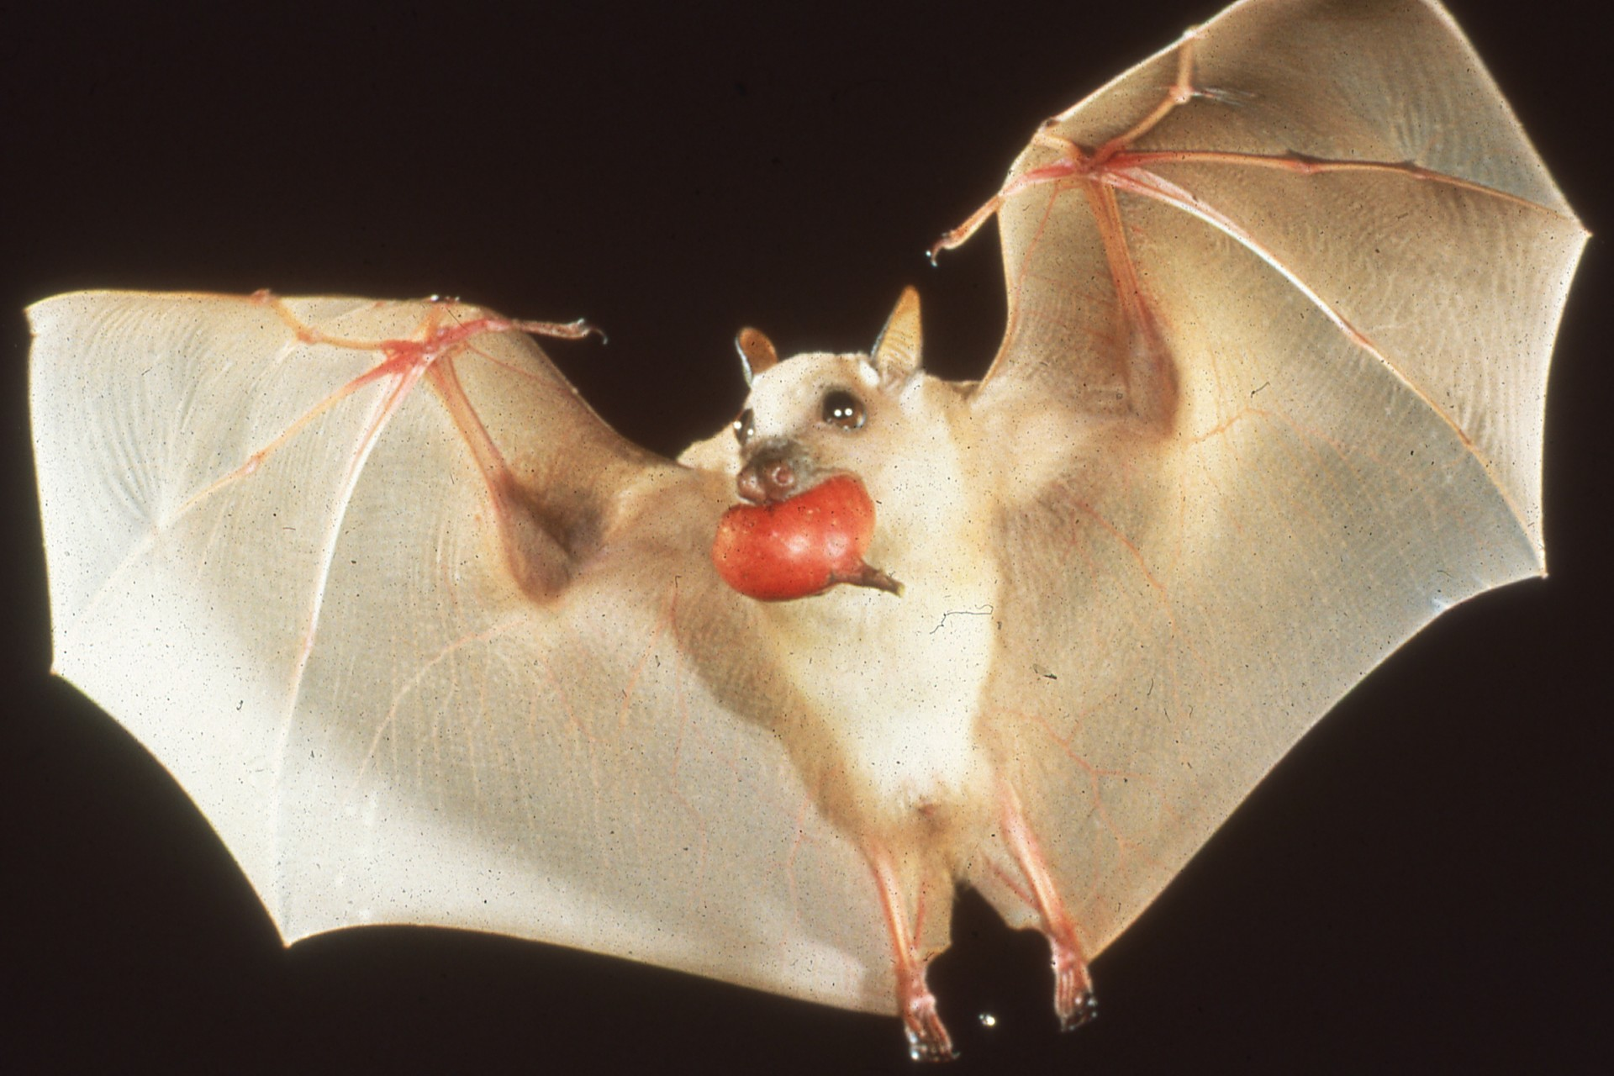
Notes:
Most bats prefer to carry fruit away from the tree before eating, apparently to avoid predators.

Slide 45
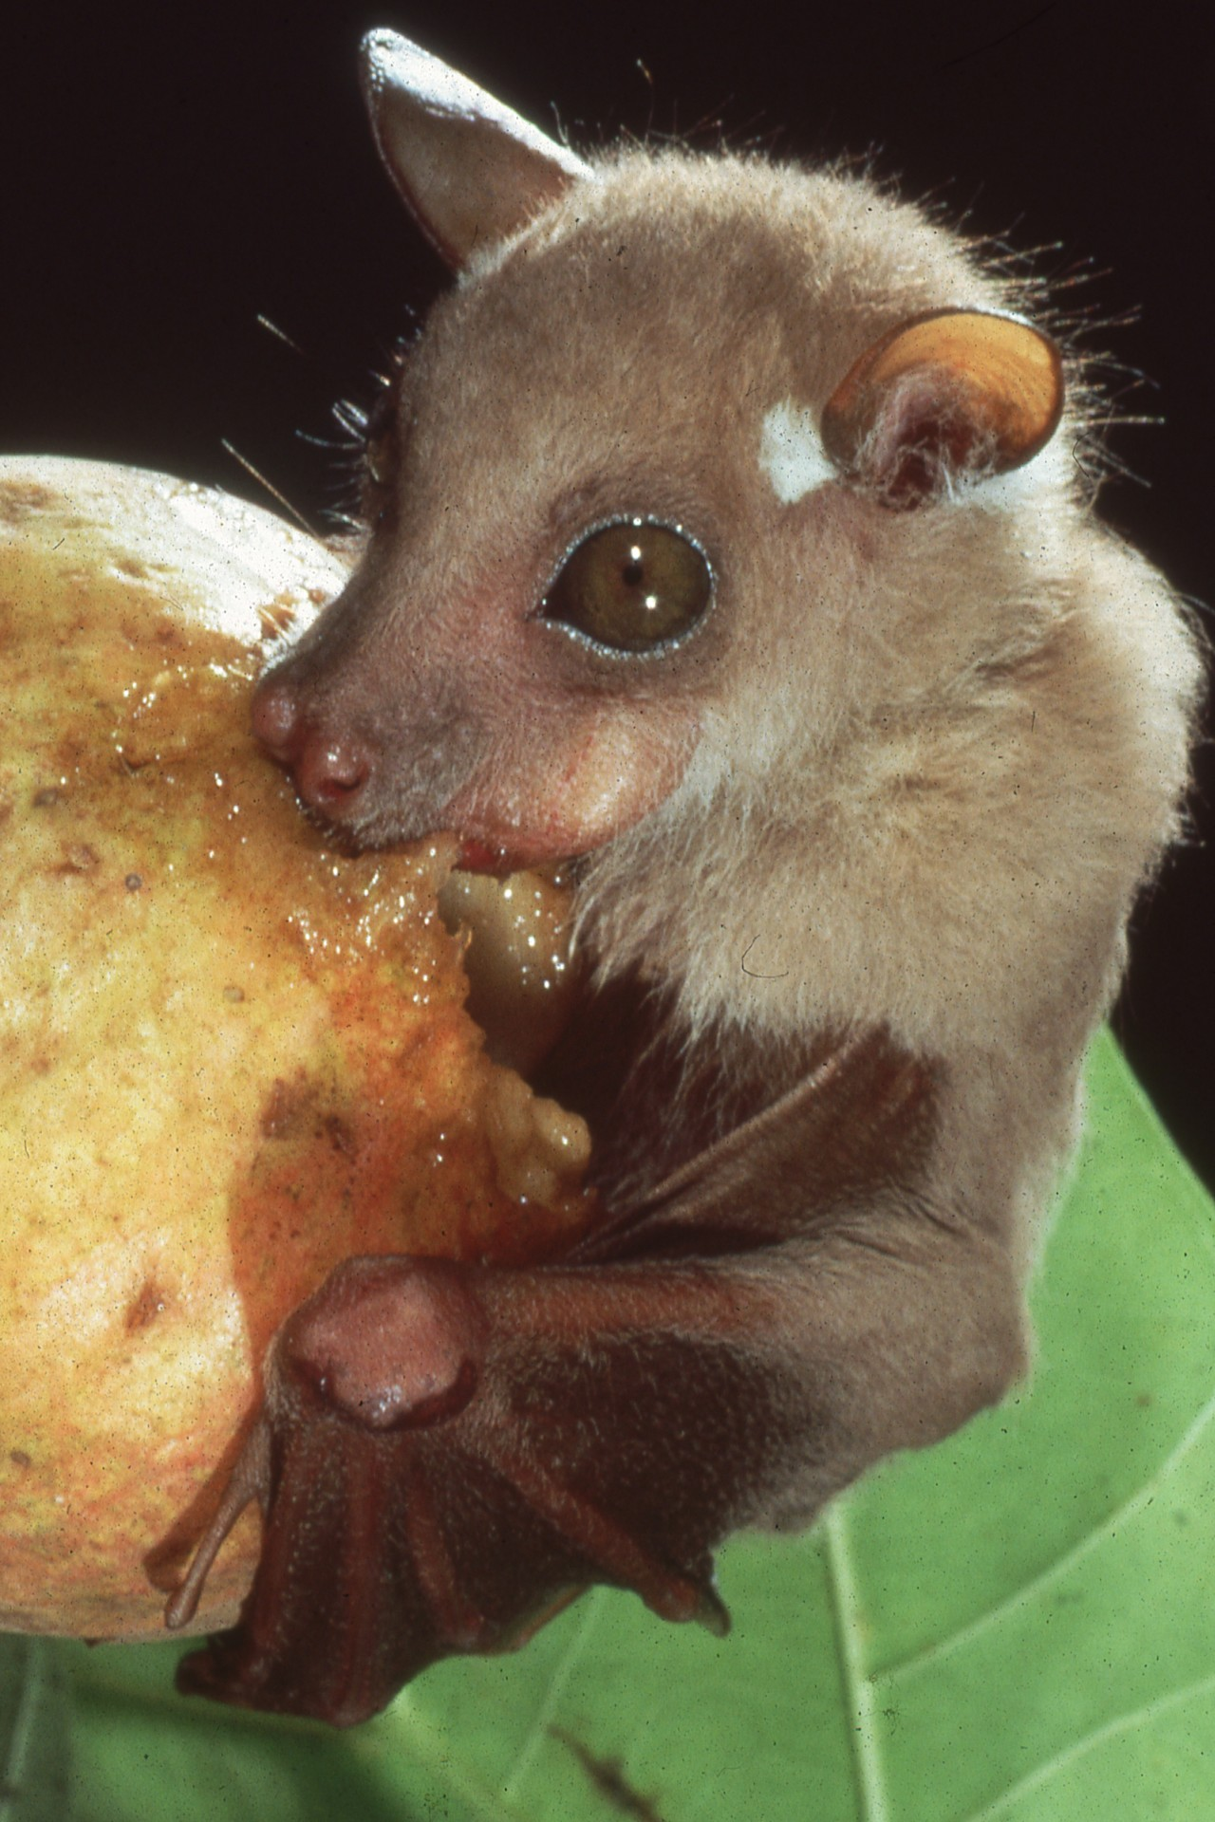
Notes:
This dwarf epauletted bat, for example, may eat two and half times its body weight in a single night. It digests entire meals in only 15 minutes, eliminating large quantities of seeds as it flies between feeding sites.

Slide 46
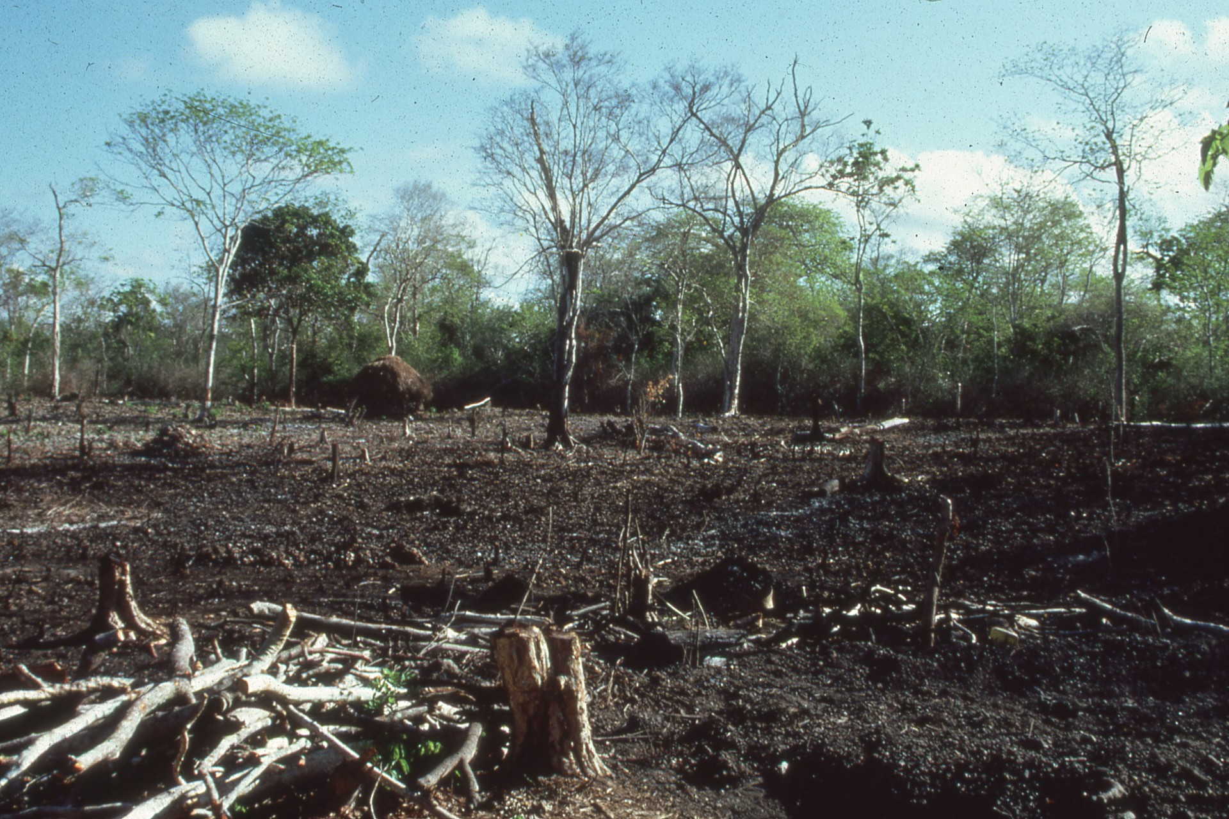
Notes:
Such bats do not hesitate to cross cleared areas and sometimes travel up to 50 kilometers or more in a single night.

Slide 47
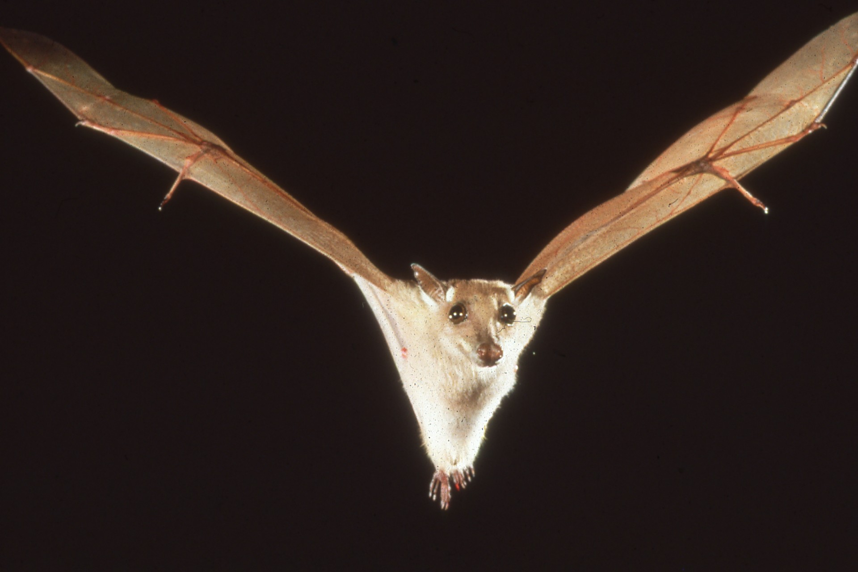
Notes:
In Africa, up to 95% of forest regrowth on cleared land comes from seeds dropped from bats like this. In contrast, birds and other animals drop seeds mostly beneath existing trees.

Slide 48
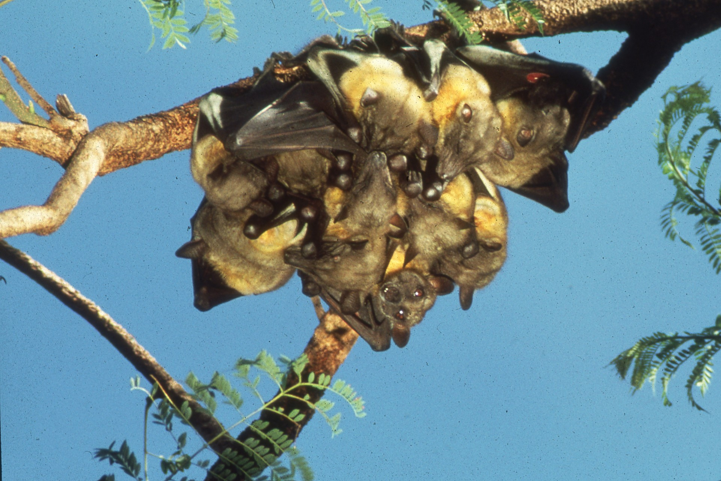
Notes:
Straw colored flying foxes illustrate the vital ecological and economic role played by many flying foxes.

Slide 49
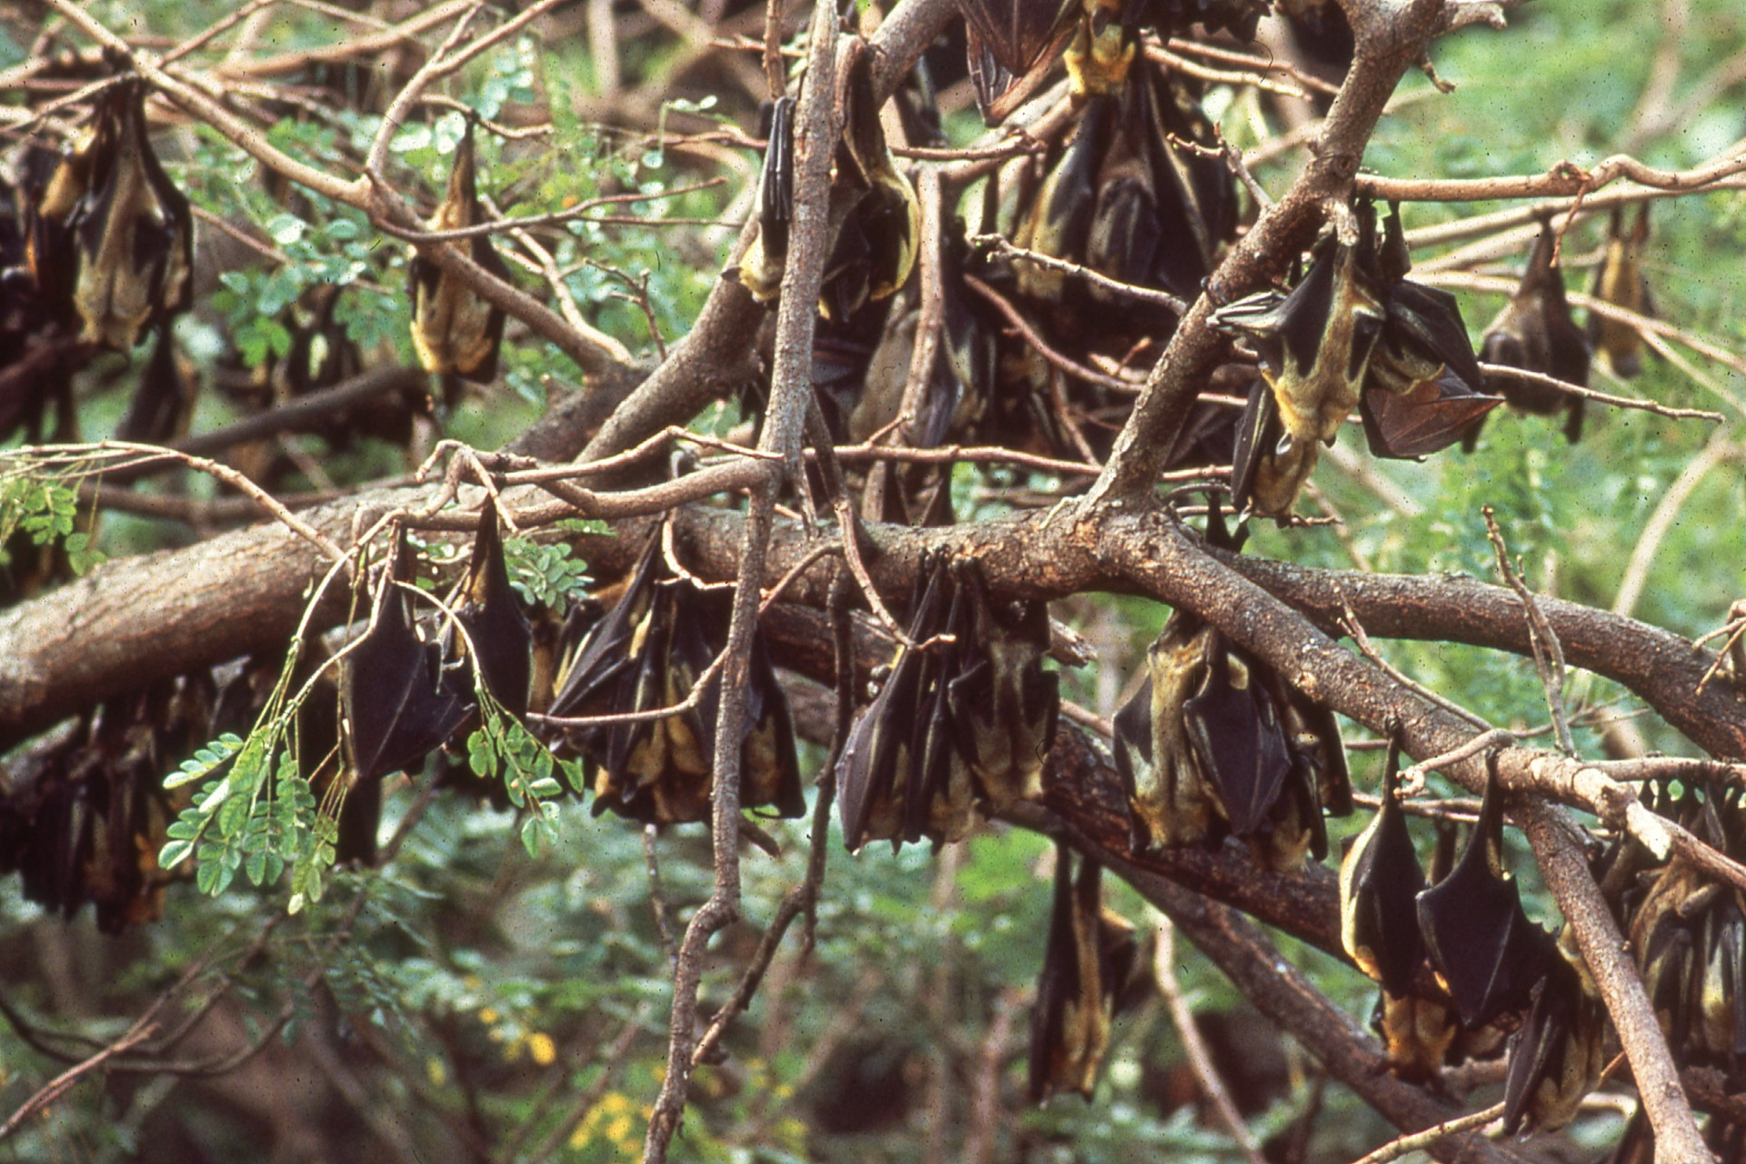
Notes:
Only a few breeding colonies of these bats are known in all of West Africa, but each contains up to a million or more individuals.

Slide 50
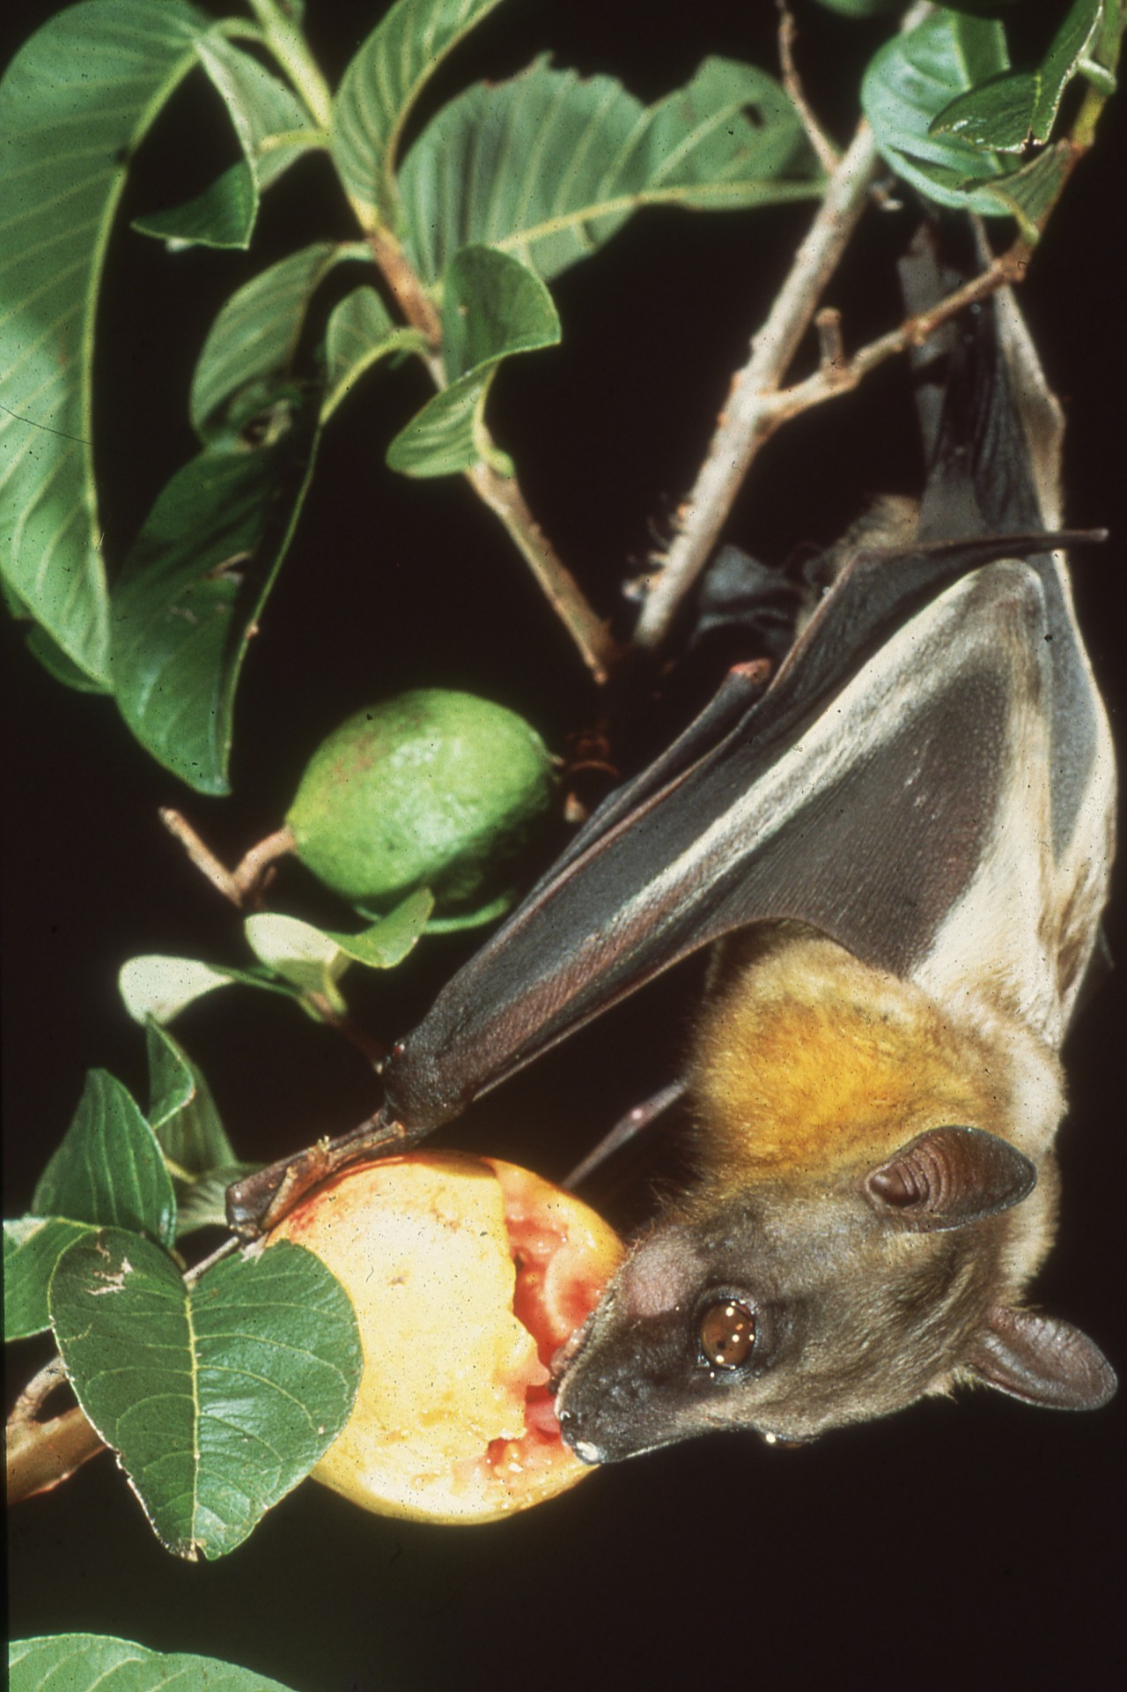
Notes:
Bats from just one of these colonies pollinate flowers and disperse seeds for thousands of trees nightly, …

Slide 51
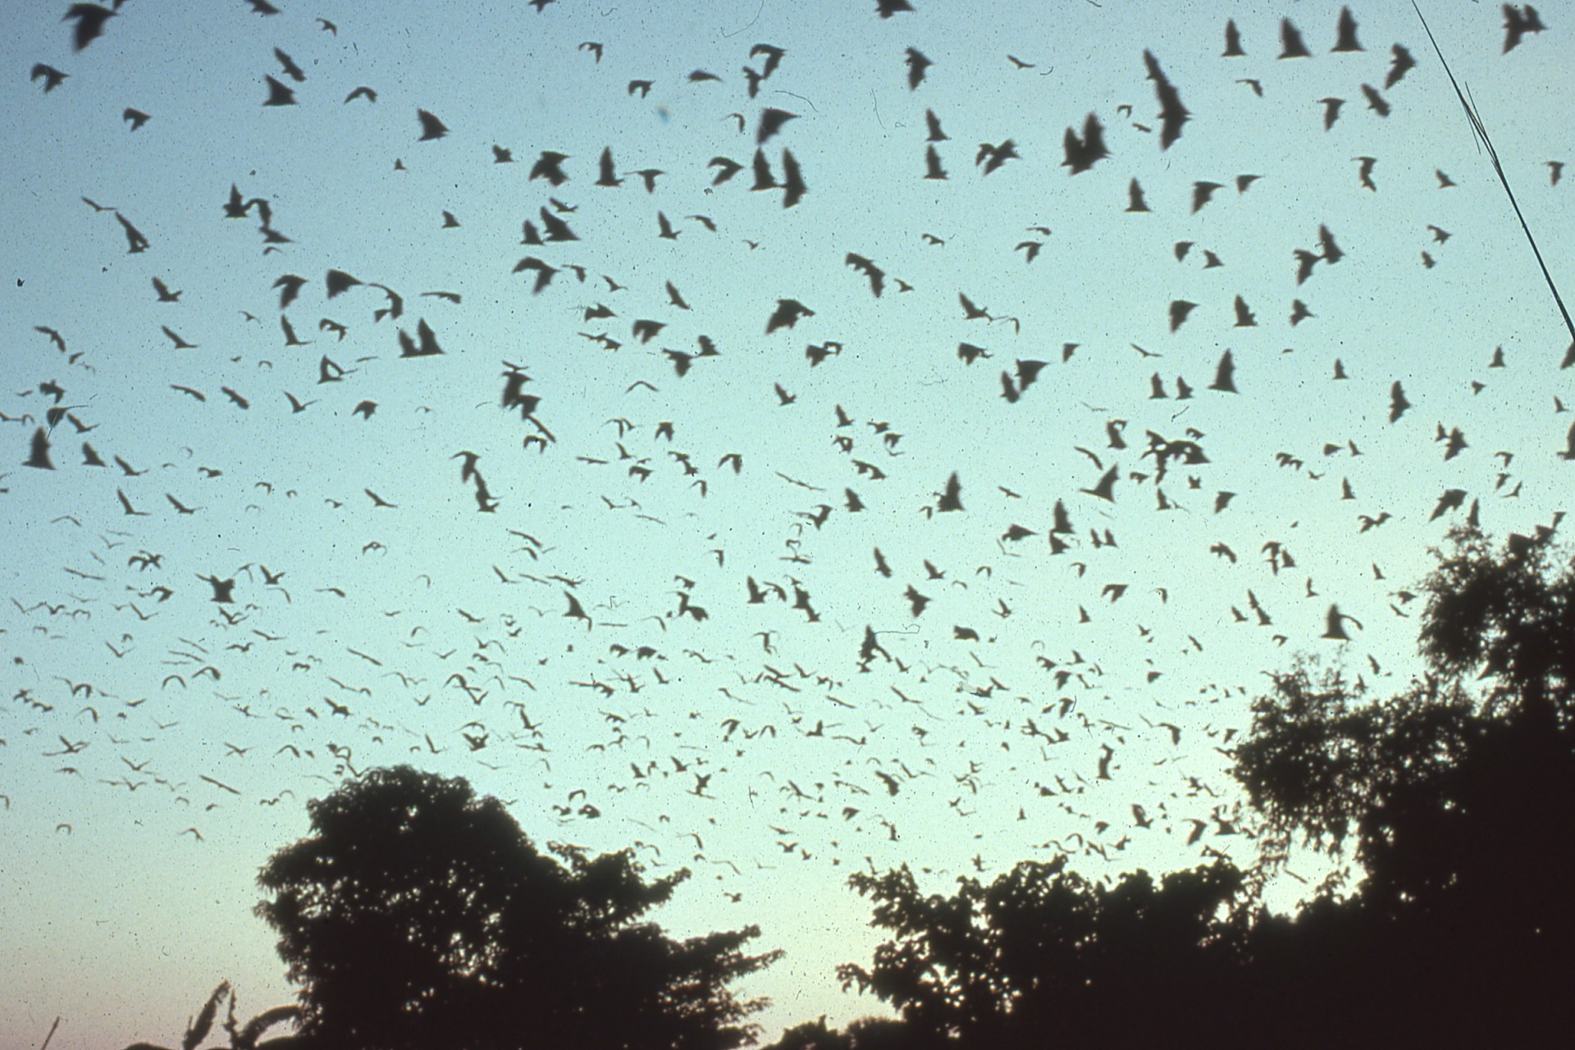
Notes:
…covering vast areas in annual migrations. Many African tree species rely on them. Just one, the Iroko tree, produces an annual timber harvest valued at roughly $100 million dollars.

Slide 52
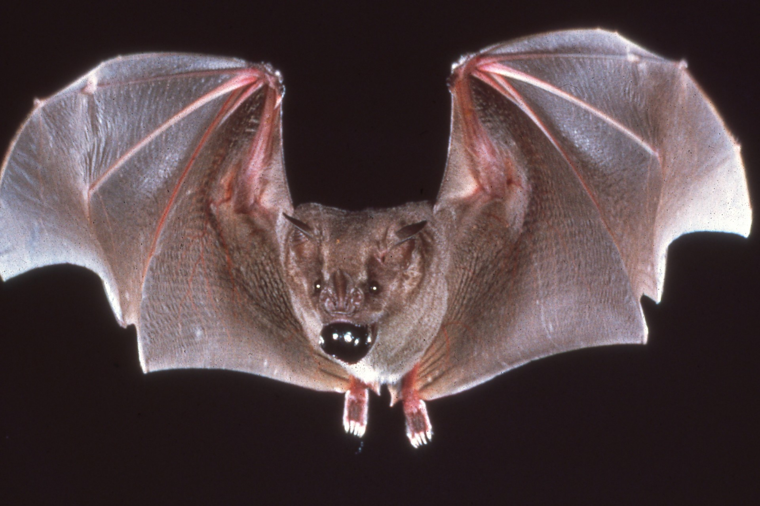
Notes:
This Jamaican fruit-eating bat is carrying an allspice berry, one of Jamaica’s most valued export crops. Much of the harvest comes from wild trees that continue to rely on a combination of bats and birds for seed dispersal.

Slide 53
Notes:
Another is about to take a ripe almond. In the wild, many, if not most, economically important tropical fruits rely on bats for propagation.

Slide 54
Notes:
These include plantain, bananas, mangoes, guavas, breadfruit, avocados, dates, figs, and many more. Other tropical products from bat-dependent plants include balsa wood for crafts and fishing lures, kapok filler for life preservers, fibers for rope, carob for drinks and candy, and even agave juice for tequila liquor.

Slide 55
Notes:
A seemingly endless variety of flowers open or produce nectar only at night, relying on bats for pollination.

Slide 56
Notes:
The shaving brush flower in Panama opens at dusk and falls off by morning. Like many bat-dependent flowers, it is white, enabling bats to see it more easily on dark nights.

Slide 57
Notes:
This short-nosed fruit bat in Thailand is pollinating a wild banana flower. Although cultivated bananas do not produce seeds or need pollination, wild ancestral varieties continue to rely on bats. These plants are sometimes the only source of genetic material required to combat disease or improve the productivity of crops. Other commercially harvested fruits continue to depend on bats.

Slide 58
Notes:
The dawn bat, a small Asian flying fox, is the only known pollinator for the durian fruit, whose annual harvest is valued at $112 million dollars.

Slide 59
Notes:
In Latin America, balsa wood harvests also continue to rely on bats for pollination. Sadly, the great value of bats, like this, goes largely unnoticed. Even worse, millions of such highly beneficial bats are killed in poorly-managed vampire control programs that often do irreversible harm.

Slide 60
Notes:
In just one campaign, more than 8000 caves were poisoned or dynamited, killing entire ecosystems of unique life.

Slide 61
Notes:
Here, Africa’s most famous tree, the giant baobab, is about to be pollinated. Baobab flowers open only at night and are perfectly adapted for bat pollination.

Slide 62
Notes:
Only bats approach from below, in a manner likely to touch the plant’s reproductive organs, which hang beneath the nectar-filled petals. Without its bat pollinators, the baobab might die out, triggering a chain of linked extinctions of many other plants and animals.

Slide 63
Notes:
The same bats that service baobabs and other important trees too frequently are only perceived at crop pests and are killed in mass eradication programs, sometimes even in national parks.

Slide 64
Notes:
Most commercial crops, including mangoes, must be picked green for shipment. The truth is, bats do not like unripe fruits any more than we do.

Slide 65
Notes:
Bats usually eat fruits that ripen prematurely or are missed by pickers. Such fruits are lost to the farmer, whether or not bats find them. By removing these overripe fruits, …

Slide 66
Notes:
…bats actually may help farmers by reducing breeding opportunities for pests, such as these fruit flies. Farmers and their governments must be educated.

Slide 67
Notes:
Bats like this often serve as model animals for medical research. They have contributed to the development of navigational aids for the blind, birth control and artificial insemination techniques, vaccine production, drug testing, and even to a better understanding of low temperature surgical procedures. However, careless exploitation increasingly threatens their survival.

Slide 68
Notes:
Bats are among the most vulnerable to extinction of any animal on Earth. Most females produce only one baby each year. Others require up to five years to leave just two surviving offspring.

Slide 69
Notes:
Severe winters force many bats to migrate or hibernate. Those that hibernate spend the winter in only a few unique caves or mines, where they are extremely vulnerable to human disturbance.

Slide 70
Notes:
These are endangered gray bats. More than half of their entire species population winters in just this one cave in the southeastern United States.

Slide 71
Notes:
Many large colonies have been destroyed by repeated human disturbance. Educated cave explorers avoid bat hibernation caves in winter and nursery caves in summer, but many unknowingly continue to harm bats.

Slide 72
Notes:
Bats form the largest and most vulnerable colonies of any warm-blooded animal. In this Texas cave, some 20 million free-tailed bats cover thousands of square feet of cave walls. Yet, they could be destroyed by a single, vandalous act.

Slide 73
Notes:
Sites such as this are now rare and disappearing rapidly. In Europe, many bat populations are estimated to have declined by 90% or more in only twenty years and are now endangered.

Slide 74
Notes:
Greater horseshoe bats, for example, are now extinct in many areas where they were once common. In addition to their many other problems, bats like this are often inadvertently killed when poisoned by careless use of pesticides and wood preservatives.

Slide 75
Notes:
In North America, the largest bat population ever known dropped from 30 million in the 1960s to a mere 30 thousand in the 1980s, a 99.9% decline. Disastrous losses continue worldwide, often the result of intentional eradication.

Slide 76
Notes:
From Asia and Africa, to the South Pacific and Australia, vitally important flying foxes are declining rapidly. Several species are already extinct.

Slide 77
Notes:
Once vast populations have been decimated by poorly informed fruit growers and their governments, …

Slide 78
Notes:
and by market hunters who slaughter tens of thousands for restaurant delicacies and aphrodisiac potions, loss of such bats could have disastrous, even irreversible consequences.

Slide 79
Notes:
How many bats can we lose before their numbers become too few to service rainforests and other ecosystems?

Slide 80
Notes:
This program was produced by Bat Conservation International, an organization dedicated to reversing the alarming trend of bat decline and extinction. We are beginning to make progress, but we need your help. It is our hope that you will wish to join us in doing everything possible to save these long-misunderstood, but vitally important animals.

Slide 81
An NSS Audio-Visual Library Presentation
Bats:
Myth and Reality
Bat Conservation International
Original slide program S404
Slides digitized by David Caudle
PowerPoint program created by Jim McConkey
81 slides, with script in presenter notes
PowerPoint created 1/27/2021
National Speleological Society
6001 Pulaski Pike
Huntsville, AL 35810-1122
256- 852-1300
nss@caves.org
https://caves.org/

